Slide 1
The Israeli-Palestinian Conflict:
Territorial or Existential?
Nevet Basker
March 2011
Notes:
Created by Nevet Basker, www.BroaderView.org. © All rights reserved.
Introduce myself & my background
Why do we care? We need to know in what debate we are engaging, and what the agenda is, to be effective in the discussion.

Slide 2
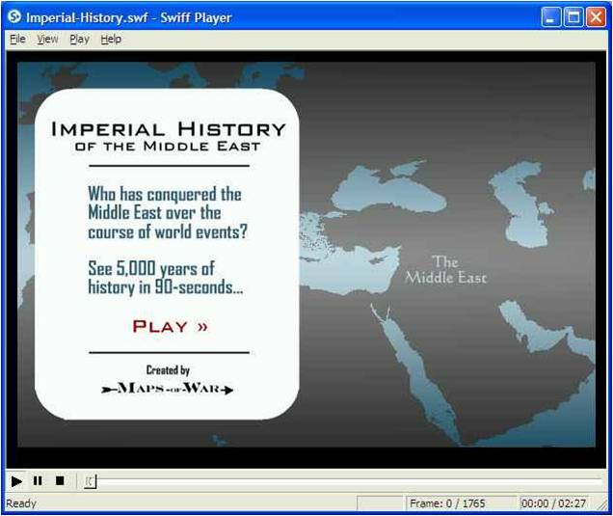
Notes:
Source: Maps of War, used with permission (http://www.mapsofwar.com/sharing.html)
The file “Imperial-History.WMV” should be in the same directory as this PowerPoint file.
Our 5,000-year story starts with the Kingdom of Egypt at about 2700 BCE, the time of the pharaohs. (See the timeline at the bottom.)
Later the Hettite Empire ruled from Anatolia (today's Turkey) to Syria.
The Biblical Kingdom of Israel, the first Jewish nation-state, was established around 1000 BCE.
It remained as the independent Kingdom of Judea when the Assyrians took over the rest of the Middle East.
But was conquered by the Babylonians in 586 BCE, resulting in the first Jewish exile.
Then the Persians took over....
….followed by the Greek (Macedonian Empire). This included another 200-plus years of Jewish independence, from the Maccabean revolt to the Romans’ destruction of the Second Templein 70 CE.
The Roman Empire dissolved into the Byzantine (East Roman) empire in the 4th Century.
Then we had the Persian Sassanid Empire, conquered by and absorbed into the Islamic Caliphate around 650 CE.
The Seljuks, a Turco-Persian Muslim dynasty, ruled in the 11th Century.
In 1099 European Crusaders established the Kingdom of Jerusalem. They were defeated in 1187 by Saladin, a Kurdish Muslim.
The Mongols from Central Asia built a massive empire during the 13th and 14th centuries.
The Ottoman Empire, at its height, spanned three continents. The Turks ruled the Middle East for over 400 years until losing World War I.
The winners, Britain and France, split the spoils and carved out independent nation-states, including the state of Israel. The 20th Century was the Era of Independence, starting with Egypt in 1922 and ending with Algeria in 1962, creating the map of the modern Middle East as we know it today,

Slide 3
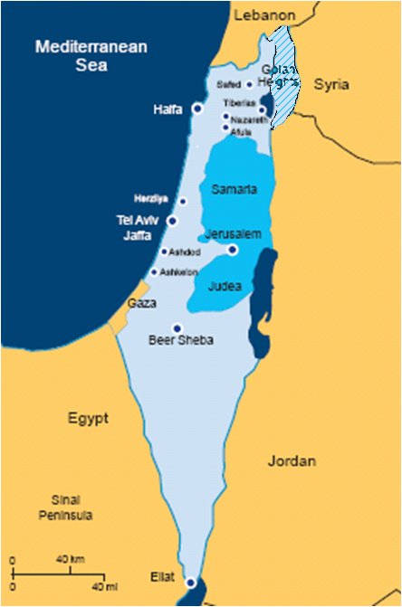

It’s Both!
Territorial
Existential

Slide 4
TWO Conflicts in One!
Different objectives
Different players
Different themes
But…
Same land
Similar terms
Some confusion

Slide 5
The Territorial Conflict

Slide 6
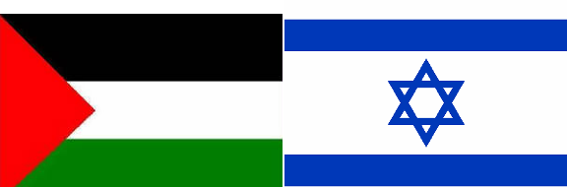

Territorial Conflict: Objective
“Two-State Solution”
Self-determination for Jews & Palestinians
  Two states for two peoples
  Minority rights
Peaceful co-existence
  Mutual recognition
  Secure and recognized borders

Slide 7
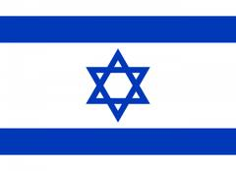




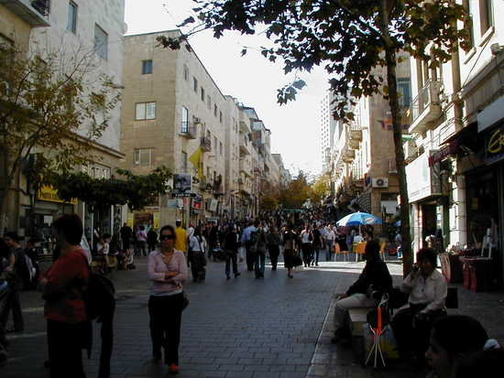




Territorial Conflict: Players
Notes:
Israel street scene: Ben Yehuda Street, Jerusalem http://www.travelpod.com/travel-photo/grannytravels2/israel_-_2005/1133516640/crowds_on_ben_yehuda_street.jpg/tpod.html
Who is involved in the debate over the territorial conflict?
Israeli government (since 1992)
U.S. Government
United Nations
European Union
American Jews (most)
J Street
Peace Now
Palestinian Authority (sometimes)
Arab League (sometimes)
Israeli people (most)
Many other NGOs

Slide 8
Territorial Conflict: Themes
Independent Palestine alongside Jewish Israel, in peace and security
U.N. Resolution 181 (1947 Partition Plan)
U.N. Resolution 242 (1967 “land for peace”)
“1967 occupation”
Oslo Accords (1993)
Quartet “Roadmap” (2004)
Security fence/ separation barrier

Slide 9
Territorial Conflict: Issues
Range of possible compromise
Borders
Settlements
Jerusalem
Security
Who speaks for the Palestinians?
Fatah legitimacy
Hamas in Gaza
Turmoil in Arab world

Slide 10
The Existential Conflict

Slide 11
Existential Conflict: Objective
The end of Israel as a Jewish state
Conventional military destruction
Nuclear weapons
Terrorism [?]
Demographic changes
Delegitimiza-tion

Slide 12

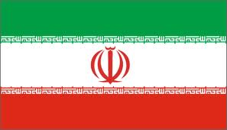



Existential Conflict: Players
Notes:
Iran
Hamas
Hezbollah
Muslim Brotherhood
Palestinian Authority (often)
Global BDS movement (essentially)

Slide 13
Existential Conflict: Themes
All of Israel is Palestine
“From the River to the Sea”
“1948 occupation”
Palestinian “right of return”
U.N. Resolution 194
No Jewish rights at all!
Denying Jewish ties to the land
Jewish “colonialism”
Demonization of all Jews

Slide 14
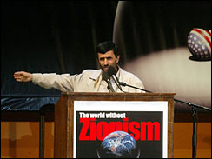
Notes:
http://www.honestreporting.com/articles/45884734/critiques/Iran_A_Threat_to_Israel_and_the_World.asp
Time and time again, Iranian President Mahmoud Ahmadinejad has stated that Israel should not exist. Moreover, he has done so with no significant domestic dissent. When the leader of a sovereign nation makes unequivocal statements without domestic opposition, those statements serve as the basis of national policy. It is critical to note that Ahmadinejad's statements go beyond opposition to Israeli policies, he is speaking of Israel's very existence.
In October 2005, Ahmadinejad called for Israel (actually the "Zionist regime" since Iran refuses to use the word "Israel") to be "wiped off the face of the map" in a keynote address to the Iranian-government sponsored "World without Zionism" conference. Such sponsorship is, in itself, incitement to genocide.
Ahmadinejad has also said:
"The real cure for the conflict is elimination of the Zionist regime."
"The way to peace in the Middle East is the destruction of Israel."
"Like it or not, the Zionist regime is heading toward annihilation."
"The Zionist regime is a rotten, dried tree that will be eliminated by one storm."
(For sources of these quotes and more, see The Israel Project, Iran's Leaders: In their own words, “http://www.theisraelproject.org/site/apps/nl/content2.asp?c=hsJPK0PIJpH&b=689705&ct=2900361)
For full text of Ahmedinajad’s “World Without Zionism” keynote address, see http://www.iranfocus.com/modules/news/article.php?storyid=4164

Slide 15
Hamas
Notes:
http://palwatch.org/pages/allmaps.aspx?fld_id=731&doc_id=1726

Slide 16
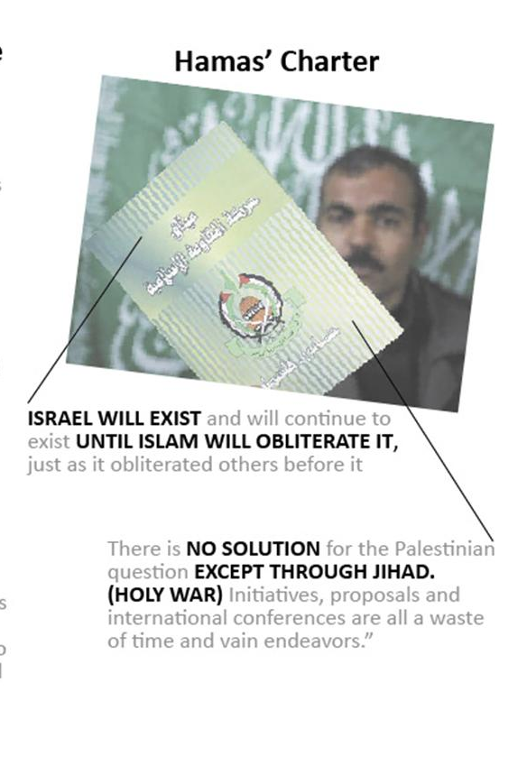
Notes:
It’s not just the symbol…. The official Hamas charter says that “Israel will exist until Islam obliterates it” and that “There is no solution except through holy war,” and that all endeavors at peace are a waste of time. This is because Hamas believes that it can not exist in the ways of God (Allah) as long as Israel Exists.

Slide 17

Al-Quds Brigades (Palestinian Islamic Jihad)
Notes:
http://palwatch.org/pages/allmaps.aspx?fld_id=731&doc_id=1727

Slide 18

Al Fatah
Notes:
http://palwatch.org/pages/allmaps.aspx?fld_id=731&doc_id=1725

Slide 19

Palestinian National Charter (1968)
Article 1. Palestine is the homeland of the Arab Palestinian people …
Article 2. Palestine, with the boundaries it had during the British Mandate, is an indivisible territorial unit.
Article 5. The Palestinians are those Arab nationals who, until 1947, normally resided in Palestine regardless of whether they were evicted from it or have stayed there. Anyone born, after that date, of a Palestinian father—whether inside Palestine or outside it—is also a Palestinian.
Article 9. Armed struggle is the only way to liberate Palestine. This it is the overall strategy, not merely a tactical phase.
Article 15. The liberation of Palestine, from an Arab viewpoint, is a national duty and it attempts to repel the Zionist and imperialist aggression against the Arab homeland, and aims at the elimination of Zionism in Palestine.
Article 19. The partition of Palestine in 1947 and the establishment of the state of Israel are entirely illegal, regardless of the passage of time …
Notes:
http://avalon.law.yale.edu/20th_century/plocov.asp

Slide 20
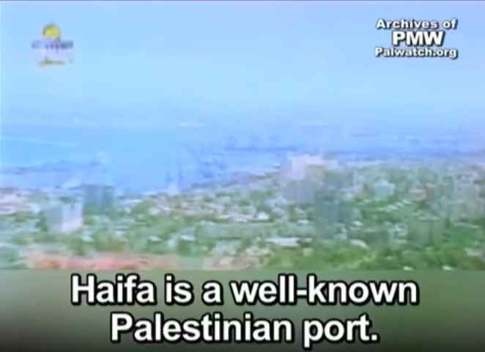
1’10”
Notes:
1’10”
Source: Palestinian Media Watch
http://palwatch.org/main.aspx?fi=466
http://www.youtube.com/watch?v=TMw755MDJ5k

Slide 21
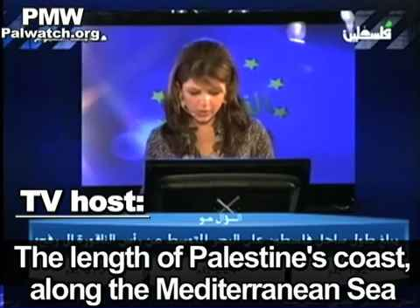
0’42”
Notes:
0”41”
Source: Palestinian Media Watch
http://palwatch.org/main.aspx?fi=408
http://www.youtube.com/watch?v=skhKdv5OwbA

Slide 22
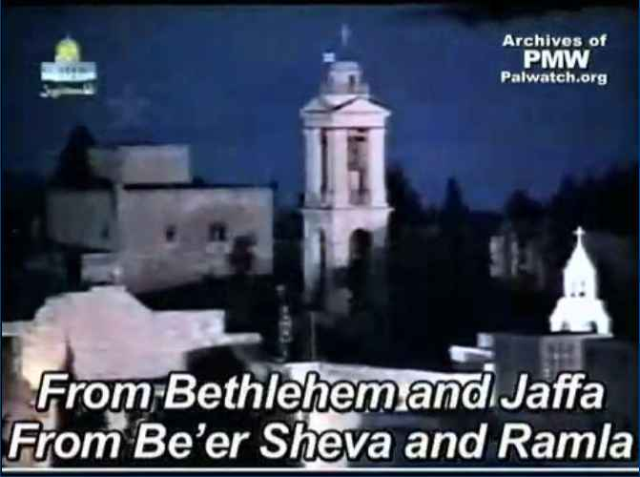
0’43”
Notes:
0’43”
Source: Palestinian Media Watch
http://palwatch.org/main.aspx?fi=450&fld_id=450&doc_id=971
http://www.youtube.com/watch?v=JW2fwuBWyHI

Slide 23
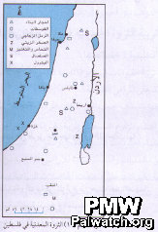
7TH Grade Geography Textbook:
“Mineral Resources in Palestine”
Notes:
http://palwatch.org/pages/allmaps.aspx?fld_id=550&doc_id=2520
"Geography of Palestine, 7th grade" Title of map: "Mineral Resources in Palestine"
The map title purports to show locations of minerals in "Palestine", but the map includes locations of minerals found in Israel, for example near Acre and Haifa.
Map in Palestinian Authority schoolbook published in 2008, currently in use.
Jan. 1, 2010

Slide 24
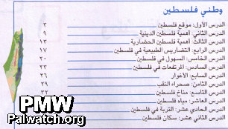
4TH Grade National Education
Textbook: Table of Contents
Notes:
http://palwatch.org/pages/allmaps.aspx?fld_id=550&doc_id=2441
"National Education Part 1, 4th grade" This image was taken from the schoolbook's table of contents. This group of chapters is entitled “Palestine My Nation.” The map, which shows both Israel and the Palestinian territories, gives the false impression that “Palestine” covers the area of Israel.
Map in Palestinian Authority schoolbook published in 2005, currently in use. Jan. 1, 2010

Slide 25
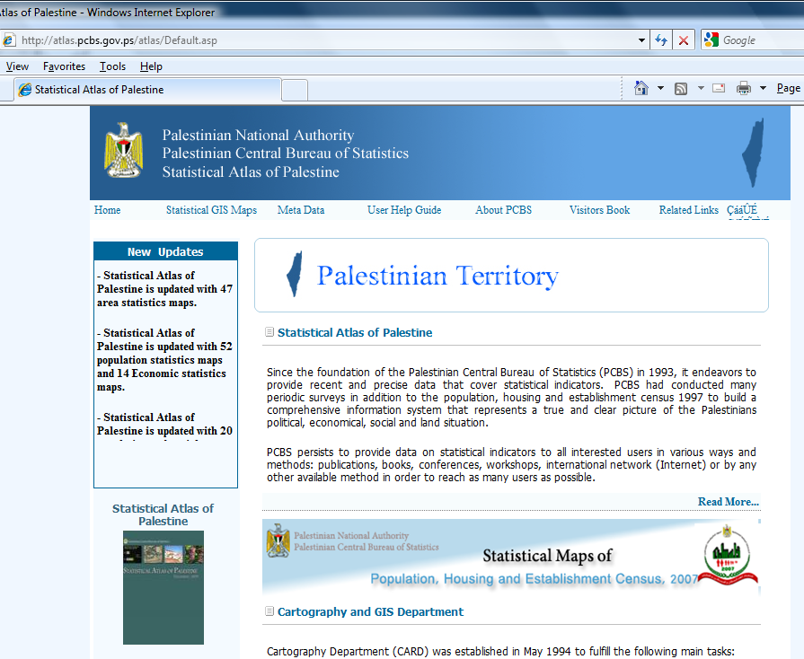
PA Government Agencies
Notes:
http://atlas.pcbs.gov.ps/atlas/Default.asp, Retrieved March 1, 2011

Slide 26
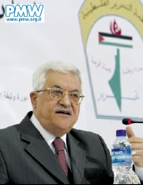
Mahmoud Abbas at PA Headquarters
Notes:
http://palwatch.org/pages/allmaps.aspx?fld_id=727&doc_id=493
Abbas speaks in his headquarters in front of map erasing Israel Fatah party emblem: the Palestinian flag over map of "Palestine" that erases all of Israel. Al-Ayyam Nov. 24, 2008

Slide 27
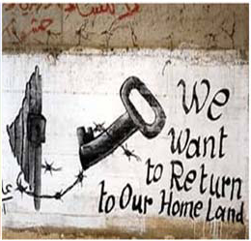
Notes:
Source: The UN-NGO Connection: Spreading the Message of Hate and Terrorism, Eye on the UN, June 12, 2006
http://www.eyeontheun.org/assets/attachments/misc/2006_UN-NGO_Report.pdf

Slide 28

Notes:
UN-Accredited NGO
Source: Eye on the UN
http://www.eyeontheun.org/view.asp?l=11&p=393
The Face of the UN-accredited NGO
Distributed at UN Human Rights Council, September 2007 by the UN-accredited NGO BADIL (Resource Center for Residency and Palestinian Refugee Rights) Accredited by the UN Committee on the Exercise of the Inalienable Rights of the Palestinian People, listed on the UN NGO database on the Question of Palestine and in Special Consultative Status with ECOSOC. (http://domino.un.org/ngoweb.nsf/2bc97ec61d63cc29852560e1004d9155!OpenView)
The BADIL Message is Wipe Israel Off the Map. All of Israel is Illegitimate, Occupied and Belongs to Palestinians Arabs.

Slide 29


0’38”
Notes:
0’38”
Source: http://www.youtube.com/watch?v=RQcQdWBqt14

Slide 30
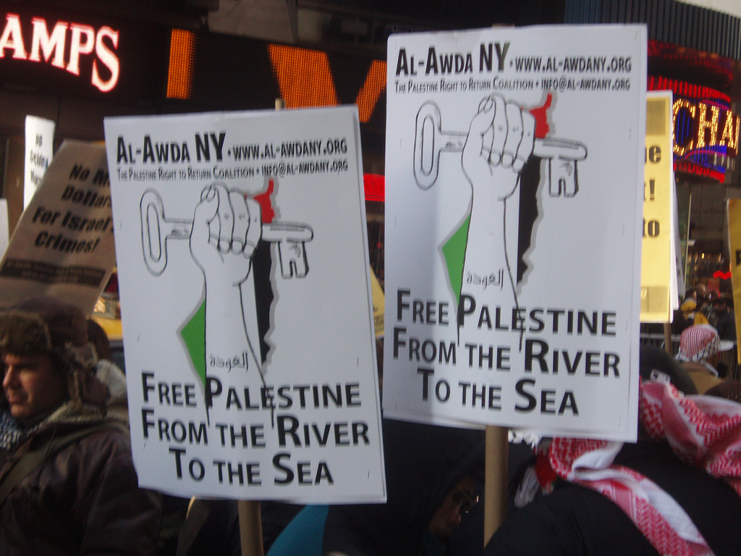
Notes:
Taken January 3, 2009
Source: http://www.flickr.com/photos/clenchner/3164405395/

Slide 31
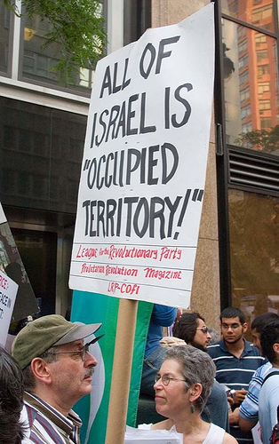
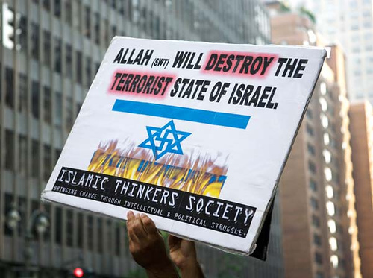
Notes:
Source: “Socialists and Moslems Rally Against Israel” by El Marco
A demonstration in front off the Israel Mission to the U.N. in N.Y. on July 18, 2006
Communists and Arabs united to chant "Death to Israel".
http://www.flickr.com/photos/imagesofperfection/sets/72157594204452111/

Slide 32




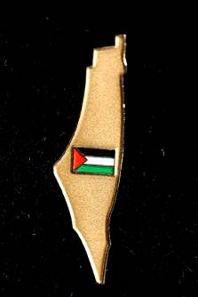
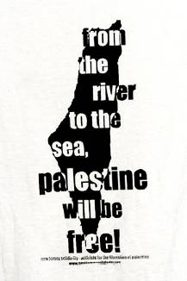
Palestinian Solidarity Conference
Georgetown, February 2006
Notes:
And in this country, too….
Pins, buttons & t-shirts available for sale at the February 18, 2006 conference at Georgetown.
Source: Israel Activist (www.standwithus.com), 2/20/06
http://www.standwithuscampus.com/modules.php?op=modload&name=News&file=article&sid=33

Slide 33

?

Slide 34
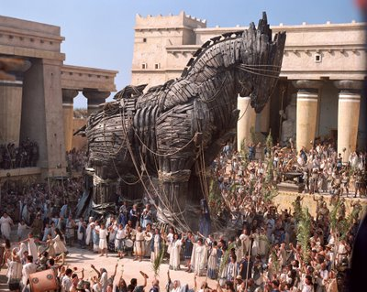
Blurring the Line
Notes:
Don’t be mislead! The Greek army used a wooden horse to trick the Trojans into opening themselves up to a massive defeat (~1200 BCE)
In one version, after a fruitless 10-year siege, the Greeks constructed a huge wooden horse, and hid a select force of 30 men inside. The Greeks pretended to sail away, and the Trojans pulled the horse into their city as a victory trophy. That night the Greek force crept out of the horse and opened the gates for the rest of the Greek army, which had sailed back under cover of night. The Greek army entered and destroyed the city of Troy, decisively ending the war.

Slide 35
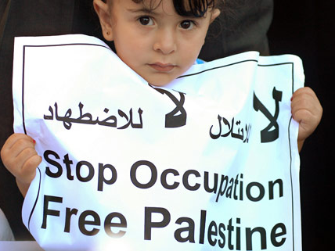
Notes:
http://electronicintifada.net/v2/article10614.shtml. Retrieved March 1, 2011
Photo credit: Mushir Abdelrahman / Maan Images

Slide 36
“End the Occupation”!
1967?
1948?

Slide 37
“Free Palestine”!
Alongside
Israel?
Replacing
Israel?
Notes:
Other versions: “Justice for Palestine”

Slide 38

Notes:
http://izzuluz.blogspot.com/ Retrieved March 1, 2011

Slide 39

Notes:
http://islamicsunrays.com/palestine-on-my-mind/
Retrieved March 1, 2011
Credit: "Free Palestine" by Ash Bahrain

Slide 40

The Test
Notes:
If you want to know which debate you’re having, ask your co-conversationalist: What is your vision for peace between Israel and the Palestinians? If they talk about a two-state solution, or any other model that preserves the rights of both people to life, security, and self-determination, then it’s the Territorial discussion, and you can move to talk about the specifics of borders, settlements, and what to do about Hamas in Gaza.
But if they’re advocates for the “one-state” or Palestinian “right of return,” or their goal is to destroy Israel by military means, or to somehow get rid of all the Jews (a la Helen Thomas), then you know you’re dealing with an Existentialist. They will talk about “justice” as opposed to “peace,” and will air grievances from 1948 or 1917 or 1882, but will not accept Israel’s existence, even though it has been the reality of the last 6-plus decades. Is that really a conversation worth having?

Slide 42
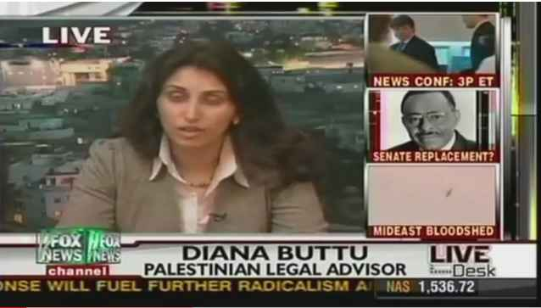
5’51”
Notes:
http://www.youtube.com/watch?v=ifZLk6Ei9-U
5’51”

Slide 43
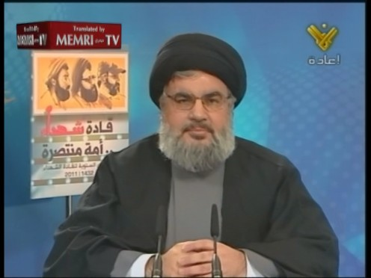
Notes:
http://www.memritv.org/clip/en/2813.htm

