Slide 1
“Operation Cast Lead” December 2008 – January 2009
Nevet Basker
StandWithUs Northwest
Notes:
On Saturday morning December 27, the sixth day of Hannukah, Israeli Air Force planes struck a number of targets of Hamas and the other Palestinian terrorist organizations in an operation dubbed “Cast Lead.” The attack came in response to a long period of rocket and mortar shell fire targeting populated areas in the western Negev , causing casualties and property damage, and seriously disrupting the daily lives of the residents. Hamas and the other organizations responded to the Israeli attack with rocket and mortar shell fire into Israel.
The objective of Operation Cast Lead was to protect the quarter of a million Israelis living in the western Negev from the continual rocket and mortar shell fire and other terrorist attacks carried out by Hamas and the other Palestinian terrorist organizations operating in the Gaza Strip. The operation intended to strike a severe blow to the terrorist networks of the various organizations and make it difficult for them to carry out rocket and mortar shells attacks, abductions and other types of lethal attacks originating in the Gaza Strip.
Israeli Prime Minister Ehud Olmert said that the action was intended primarily to improve the security of the residents of southern Israel , although it was liable to take time and patience would be required to complete the mission (announcement by the prime minister to foreign and local correspondents, December 27). On December 27 Defense Minister Ehud Barak said that Israel would strike a strong blow against Hamas to make fundamental changes in the security situation and ensure that no more rockets were fired from the Gaza Strip and that no other attacks were carried out. He said it would not be easy and the operation would not be short, but as deep and broad as required (Haaretz, December 28).

Slide 2
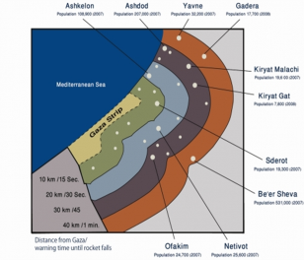
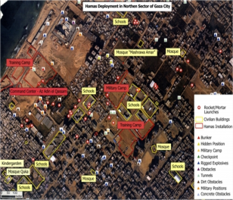
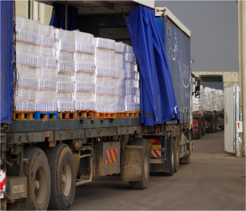
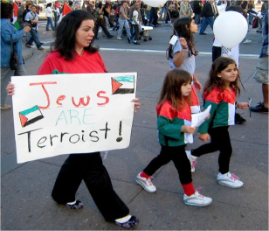
Outline
Why Israel Acted
Civilian Casualties
Humanitarian Aid
World Backlash
Q&A

Slide 3

Notes:
[Embedded video, 15seconds2.wmv]

Slide 4
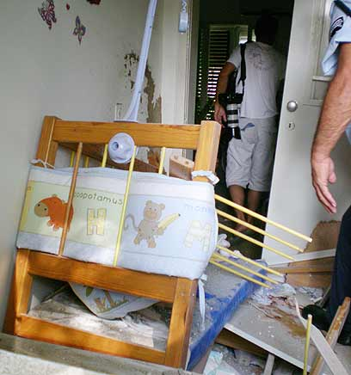
Notes:
Baby crib destroyed by Qassam, July 23, 2007
http://www.ynetnews.com/articles/0,7340,L-3428921,00.html

Slide 5
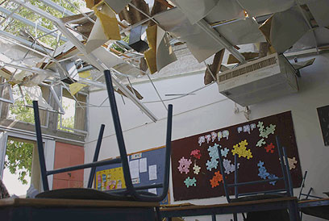
Notes:
High-school classroom in Sderot hit by Qassam rocket, May 17, 2007
Source: http://www.ynetnews.com/articles/0,7340,L-3401172,00.html

Slide 6
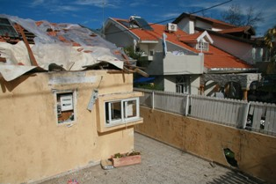
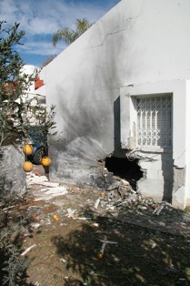
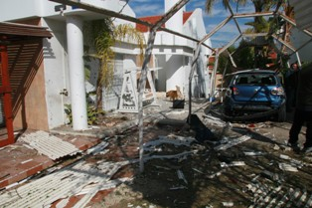
Notes:
Top left: A home that took a direct hit on Jan. 16, 2008 in Sderot
Bottom left: The garage of a Sderot home that was hit by a short-range rocket fired from Gaza on Jan. 17, 2008
Right: A Sderot home that took a direct hit on Jan. 17, 2008
(Source: The Israel Project, http://www.theisraelproject.org/site/?c=hsJPK0PIJpH&b=3831671)

Slide 7
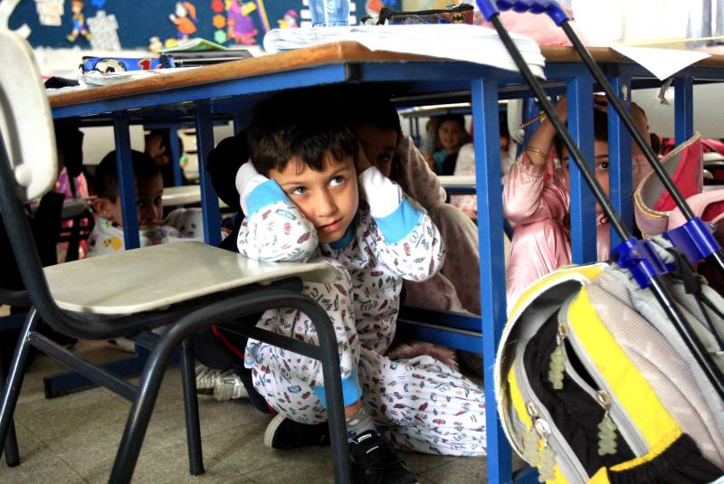
Notes:
Photo credit: Embassy of Israel, January 3, 2008

Slide 8
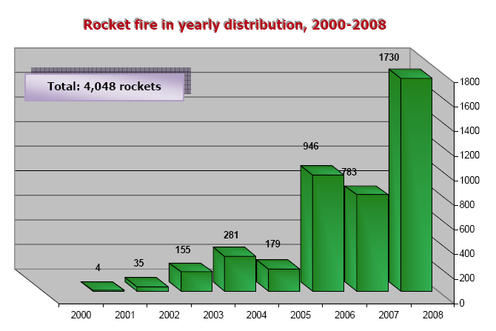
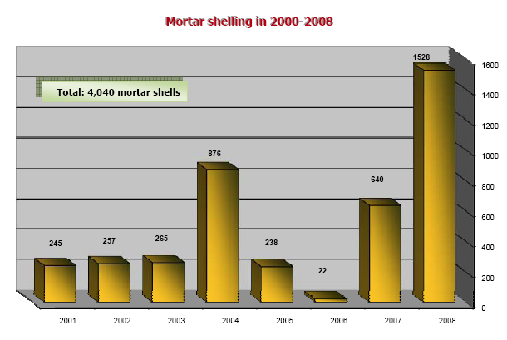
Eight Years of Rockets & Mortars
Notes:
Source: Intelligence and Terrorism Information Center at the Israel Intelligence Heritage & Commemoration Center (IICC), “Summary of rocket fire and mortar shelling in 2008,” January 1, 2009. http://www.terrorism-info.org.il/malam_multimedia/English/eng_n/pdf/ipc_e007.pdf

Slide 9
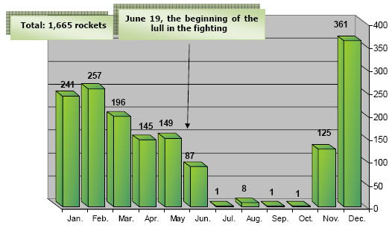
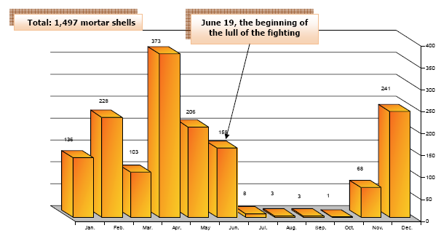
Notes:
Source: Intelligence and Terrorism Information Center at the Israel Intelligence Heritage & Commemoration Center (IICC), “Summary of rocket fire and mortar shelling in 2008,” January 1, 2009. http://www.terrorism-info.org.il/malam_multimedia/English/eng_n/pdf/ipc_e007.pdf

Slide 10
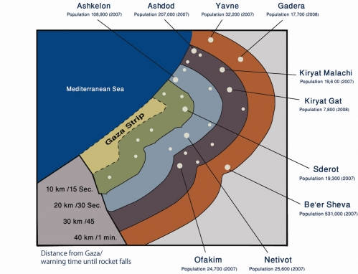
Rocket Range
Notes:
http://idfspokesperson.com/2009/01/21/rocket-and-population-map-21-jan-2009/
This map shows the rocket ranges as they relate to the population of southern Israel, and how much time people have to take cover given the distance the rocket travels. Those living in the 10 kilometer range have 15 seconds to find safety once the alarm sounds, those in the 20 km range have 30 seconds, 30 km - 45 seconds, and 40 km a minute. With the increased range of the rocket fire from Gaza, nearly 1 million people, or a seventh of Israel’s population live in danger and under threat from rocket attacks. The goal of operation Cast Lead has been to reduce the number of rocket attacks against the inhabitants of southern Israel.
Population Figures (numbers from 2007):
Ashkelon - 108,900
Ashdod - 207,000
Yavne - 32,200
Gadera - 17,700
Kiryat Malachi - 19,600
Kiryat Gat - 7,800 – Check this, doesn’t look right (IIIC says 47,900)
Sderot - 19,300
Be’er Sheva – 531,000 – Check this, doesn’t look right (IIIC says 186,800)
Ofakim - 24,700
Netivot - 25,600
(IIIC numbers from http://www.terrorism-info.org.il/malam_multimedia/English/eng_n/pdf/ipc_e007.pdf)

Slide 11
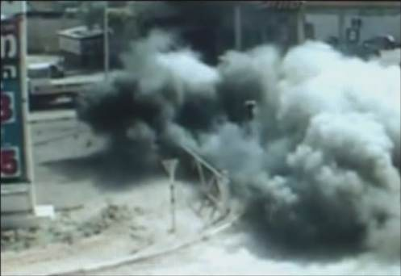
15 Seconds to Take Cover
Notes:
[Embedded video, 15seconds3.wmv, 2’06”]

Slide 12
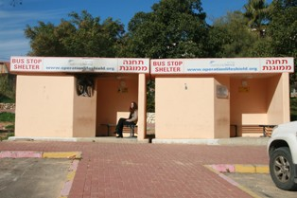
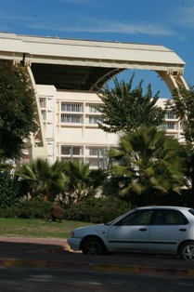
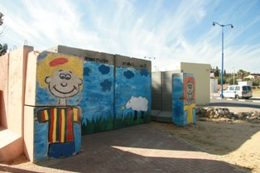
Notes:
Left: A reinforced elementary school in downtown Sderot where children study everyday under fire
Top right: Bus stops in Sderot, notably reinforced with concrete, to protect those standing in open space from the daily barrage of rockets fired from Gaza
Bottom right: A children’s bomb shelter in Sderot
(Source: The Israel Project, http://www.theisraelproject.org/site/?c=hsJPK0PIJpH&b=3831671)

Slide 13
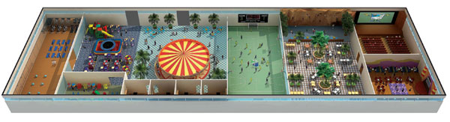
Rock Climbing Wall/ Play Equipment
Aerobics/Dance
Studio & Shelter
Children’s Play
Area (ages 7-12)
Merry-Go- Round
Movie Theater
& Shelter
Toddler Play Area & Shelter
Counseling Center & Health Clinic
Teen Disco
& Shelter
Multi-Purpose Playing Field
Café
Notes:
Sderot Indoor Playpark
The Jewish National Fund (JNF) helped build the Sderot Indoor Playground, the largest indoor playpark in Israel, set to open in November 2008. It is expected to open in November 2008 at a cost about $6 million to build and to be used by 20,000 people a year, attracting visitors from around the area.
To protect Sderot’s children, the playground will be fortified to the rigorous standards of the Israel Defense Forces. This all inclusive playground, exercise and recreational facility for children age 16 and under will provide Sderot’s youth with a place to have fun, connect with friends and be children, beyond the conflict. And parents will have peace of mind knowing that their children are playing in an environment that is safe and secure. It is estimated that the Sderot Indoor Playground will be used by 20,000 people a year. It will attract visitors from around the area and be a point of pride for the State of Israel.
Where else in the world would you find a counseling center co-located with a playground and sports field, all in a fortified structure designed to withstand missile and rocket attacks??!....
Source: JNF, http://www.jnf.org/site/PageServer?pagename=The_sapphire_society_info, Sept. 2008

Slide 14
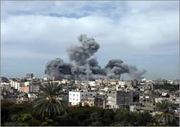
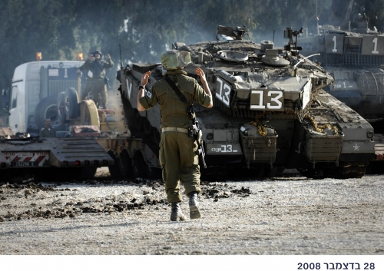
Notes:
The Israeli Air Force attacks in Gaza City (Al-Jazeera TV, December 28, 2008).
http://www.terrorism-info.org.il/malam_multimedia/English/eng_n/html/hamas_e020.htm
IDF Tanks Being Transfered Towards Gaza as Part of Operation ‘Cast Lead’
(IDF Spokesperson, December 28, 2008).
http://idfspokesperson.com/2008/12/28/idf-tanks-being-transfered-towards-gaza-as-part-of-operation-cast-lead/

Slide 15
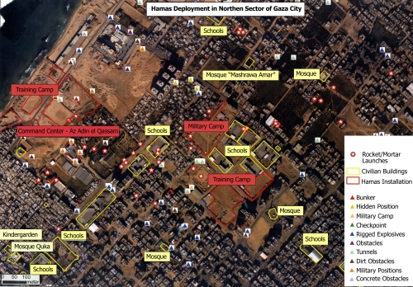
Intermingling with Civilians
Notes:
http://idfspokesperson.com/2009/01/19/idf-maps-reveal-hamas-exploitation-of-gazan-residents-19-jan-2009-1856-ist/
Hamas exploits the civilians of the Gaza strip as human shields. Here are two aerial photographs which illustrate how Hamas deploys rocket launchers within densely populated areas in the Gaza strip, next to schools, mosques and medical facilities. Residential buildings are used as arms depots and rigged with explosive charges, without any consideration given to potential civilian casualties.
White stars in red circles - rocket/mortar launchers
Yellow lines - civilian buildings
Red lines - hamas installations
Red triangles - bunkers
Yellow triangles - hidden positions
Blue triangles - rigged explosives
Grey triangles -tunnels
Purple triangles - obstacles

Slide 16
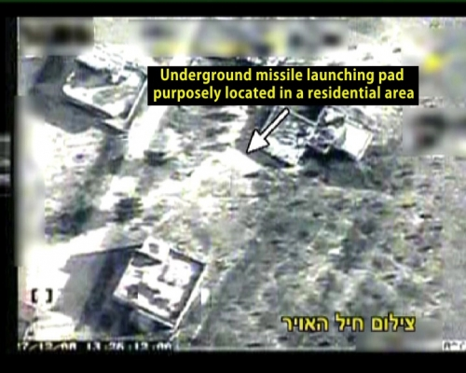
Notes:
http://idfspokesperson.com/2008/12/28/aerial-photographs-of-iaf-strike-on-rocket-launch-site-in-gaza/

Slide 17
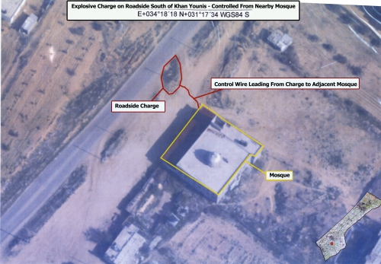
Notes:
http://idfspokesperson.com/2009/01/22/intellignece-maps-hamas-uses-mosques-and-schools-for-cover-22-jan-2009-1215-ist/

Slide 18
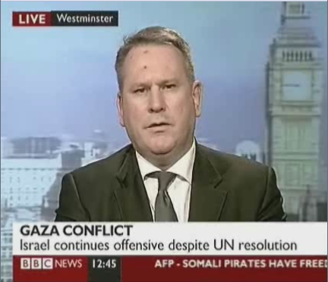
Notes:
BBC News: Military analysis
Former British Army Colonel Richard Kemp discusses the military challenges facing the IDF as they carry out Operation Cast Lead within Gaza.
Video: RichardKemp-Gaza.BBC-09.01.09.flv (4’16”)
Source: http://www.bicom.org.uk/videos/bbc-news--military-analysis
Requires video player, such as VideoLAN VLC media player (vlc-0.9.8a-win32.exe, available for download at http://www.videolan.org/vlc/.)

Slide 19
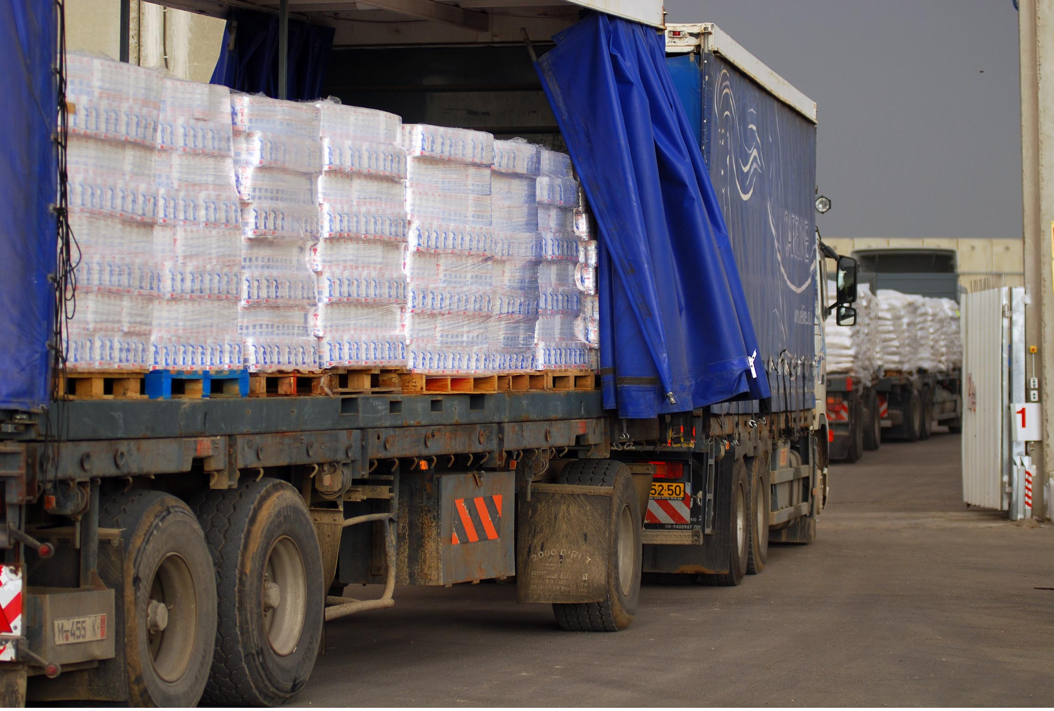
Humanitarian Aid
Notes:
Monday, December 29, 2008: Humanitarian aid transferred from Israel to the Gaza Strip through the Kerem Shalom border crossing. The convoy included 63 trucks carrying food and medical supplies, as well as 10 ambulances.
Source: IDF Spokesperson

Slide 20
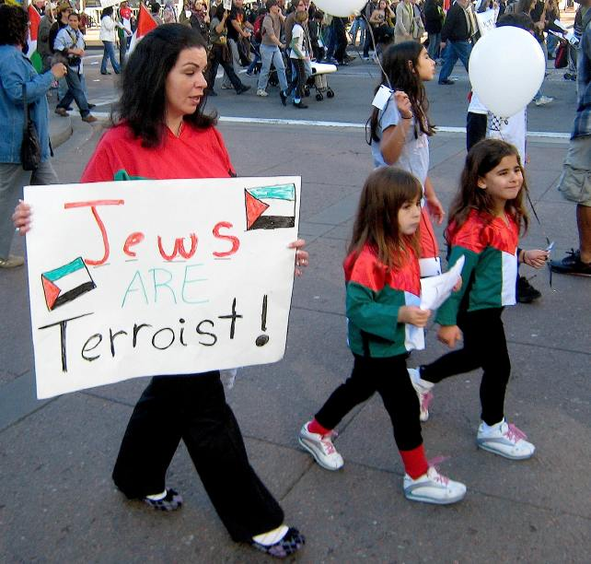
World Backlash
Notes:
Taken in San Francisco (!!), January 10, 2009
http://zombietime.com/gaza_war_protest/

Slide 21
