Slide 1
Settlements
April 2011
Notes:
Created for StandWithUs by Nevet Basker, www.BroaderView.org. © All rights reserved.

Slide 2
Agenda
Where are “settlements”?
Why were they built?
Are the settlements legal?
Are the settlements an obstacle to peace?

Slide 3
I. What Are “Settlements”?

Slide 4
Jewish Communities on the West Bank (Judea & Samaria)
Major Jewish cities
Former Jewish areas of the West Bank
East Jerusalem neighborhoods
Isolated Jewish communities and outposts

Slide 5
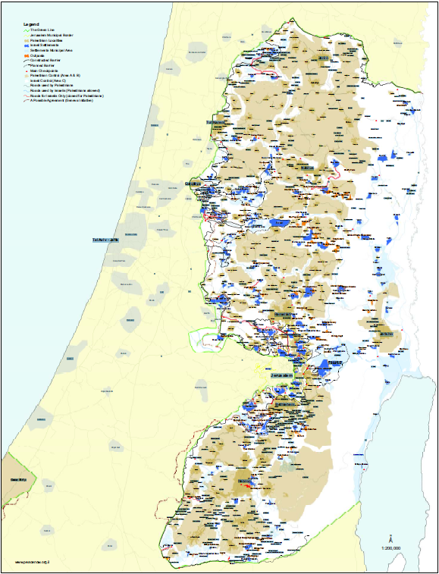
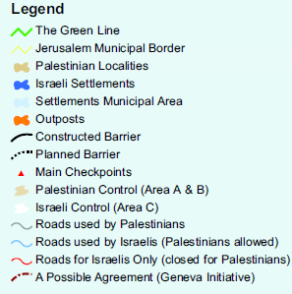
Where?
Major Blocs
Ariel
Modiin Ilit
Ma’ale Adumim
Gush Etzion
Jerusalem
Outposts
Notes:
Source: Peace Now, http://peacenow.org.il/eng/sites/default/files/SWBSide%20June%202009.pdf, retrieved Feb. 7, 2011

Slide 6
The West Bank
Cradle of Jewish civilization and peoplehood
Historic and religious Jewish significance
British Mandate 1917-1948
Occupied by Jordan 1948-1967
Captured by Israel in Six Day War
No sovereign nation claims territory
Area for future Palestinian state according to 1993 Oslo Accords
“Occupied” or “disputed” territory?
Notes:
The term “Jew” comes from “Judea”
British Mandate included provisions for Jewish immigration and settlement in the entire area of Palestine west of the Jordan River, including the West Bank

Slide 7
How Much Land Is At Stake?
Israeli Settlements:
< 5% of West Bank area (293 Km²)
Palestinian & Empty Land:
> 95% of West Bank Area (5,902 Km²)
80% of Jewish settlers
live in 43 communities
adjacent to “Green Line”
Notes:
Sources:
United Nations Office for the Coordination of Humanitarian Affairs (OCHA), July 2010, http://www.ochaopt.org/documents/ocha_opt_route_projection_july_2010.pdf
Imagining the Border: Options for Resolving the Israeli-Palestinian Territorial Issue by David Makovsky and Jackson Diehl, January 20, 2011, http://www.washingtoninstitute.org/templateC07.php?CID=558 and http://www.washingtoninstitute.org/mapImages/4d35fc943f32e.pdf

Slide 8
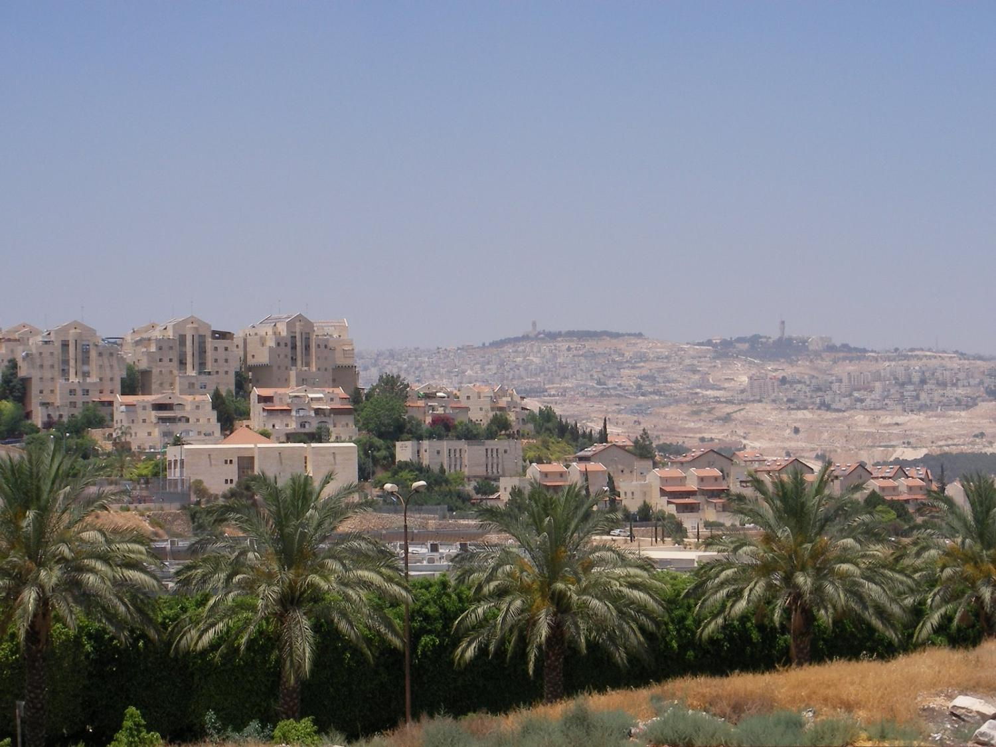
Ma’ale Adumim (pop. 34,000)
Notes:
The city of Ma’ale Adumim is only 3 miles east of Jerusalem, on the edge of the Judean Desert. The name means “red heights,” after the red rock ascent from the Dead Sea, and is mentioned in the Biblical book of Joshua. It was established in 1976 and built on public lands as a planned community and Jerusalem suburb. Ma’ale Adumim, with over 34,000 residents, has 21 schools (12 elementary schools and 9 high schools) and 78 preschools as well as the area’s largest shopping mall, country club, and public library.
Sources:
http://www.jr.co.il/ma/
http://www.jewishvirtuallibrary.org/jsource/Society_&_Culture/geo/maale.html
http://www.maale-adummim.muni.il/Page.asp?id=1 [Hebrew]
Photo: http://www.alternativenews.org/english/index.php/topics/settlers-violence/3087-israeli-settler-leaders-push-for-increased-construction-in-west-bank

Slide 9
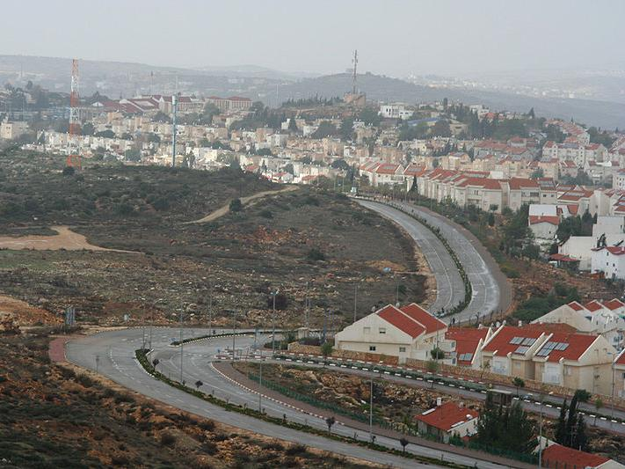
Ariel (pop. 19,000)
Notes:
The city of Ariel is home to 19,000 Israelis, a university center of 12,000 students and a growing industrial park with 27 factories employing thousands of workers.
Photo: http://en.wikipedia.org/wiki/File:Arieal,_Shomron(Storms_04).jpg
More: http://www.jewishjournal.com/community/article/la_donors_play_role_in_israeli_settlement_20100921/. Photo by Uriel Sinai/Getty Images
Ariel information (Hebrew): http://www.myesha.org.il/?CategoryID=171&ArticleID=48&Page=1

Slide 10
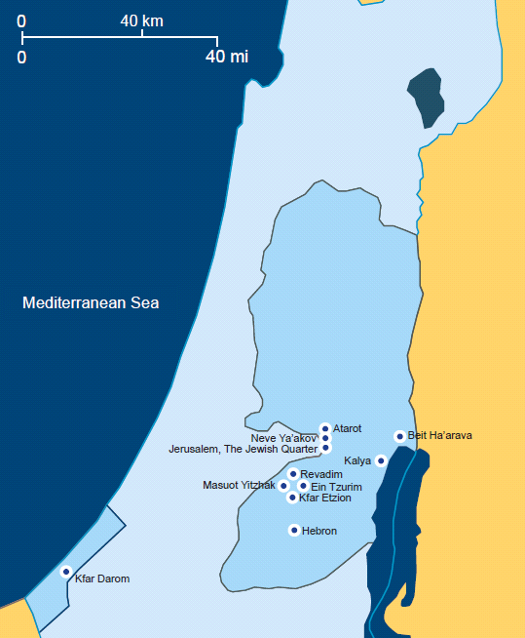
Jewish Communities Lost in the War of Independence
(1947-1949)
http://www.israelinsider.com/maps
© Koret Communications Ltd. www.koret.com
Notes:
The Etzion Bloc ("Gush Etzion" in Hebrew), was first settled in 1927 by Yemenite Jews but their community, Migdal Eder, was destroyed in the Arab riots two years later. It was again purchased and settled in 1930, and again mostly demolished by Arab riots in 1936. Jews settle the area for a third time between 1943-1947, and established four small communities—Kfar Etzion, Masuot Yitzhak, Ein Tzurim and Revadim—which were all subsequently destroyed during Israel’s War of Independence.
In January 1947, 25 Jewish soldiers from a Hagganah (Jewish pre-state military force) platoon tried to reach the besieged area, but were captured by Arabs, massacred, and their bodies mutilated. In May 1948, residents of kibbutz Kfar Etzion were able to hold off a large Arab army for three days, but eventually surrendered; 240 civilians were massacred, another 260 were captured, and the settlement was razed.
After Israel regained control of Jerusalem and the surrounding areas in the West Bank in June 1967, a new initiative was launched to resettle the Etzion area. Several of the new residents of Kfar Etzion were descendants of the people who fought and died in 1948. Kfar Etzion was the first settlement established in the West Bank after Israel’s victory in the Six Day War.
Gush Etzion includes a large city, Beitar Illit, a smaller city of Efrat, and more than a dozen other communities, with a total population of overt 40,000 residents.
History of Efrat and Gush Etzion:
http://israelinsider.net/forum/topics/lenny-bendavid-the-growth-of
http://www.jewishvirtuallibrary.org/jsource/Society_&_Culture/geo/Etzion.html

Slide 11
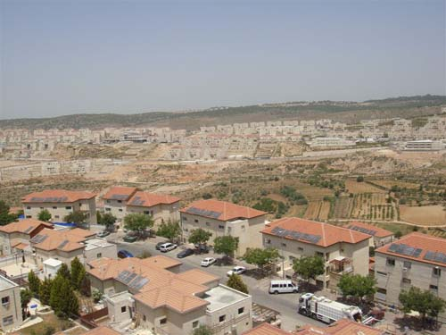
Beitar Illit (pop. 26,000)
Notes:
Source: http://betar-illit.muni.il/photoGallery/1
Other source: Newscom afplivethree242107-FILES-MIDEAST.jpg, http://www.nbn.org.il/communities/jtemplate/community/5 (below “Rentals”)
More Information on Beitar Illit
Hebrew: http://www.myesha.org.il/?CategoryID=171&ArticleID=49&Page=1
English: http://www.nbn.org.il/communities/jtemplate/community/5

Slide 12
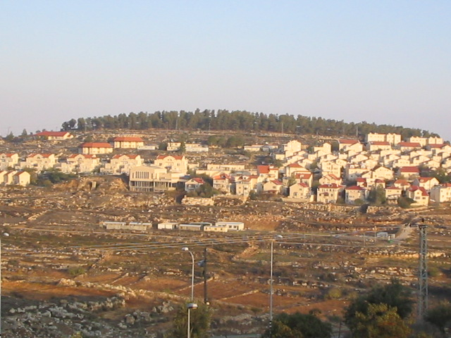
Efrat (pop. 8,500)
Notes:
Photo : http://www.seraphicpress.com/archives/2008/08/the_terrorist_i.php

Slide 13
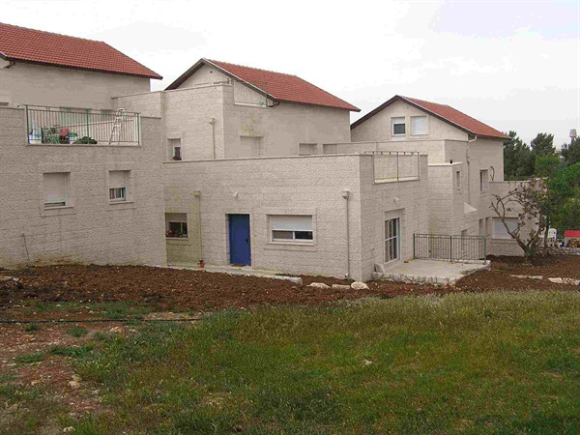
Kfar Etzion (pop. 400)
Notes:
Kfar Etzion was first established in 1927 by Jews from Jerusalem intending to build an agricultural community. The village was destroyed in 1929 as part of the Arab massacre of the Jews in nearby Hebron. A new group of pioneers re-purchased the lands in 1935 bit abandoned it amid the renewed violence of the 1936 Arab Revolt. A third attempt in 1943 brought religious socialists who escaped from Poland during the Holocaust. By fall 1947 there were almost 500 residents in Kfar Etzion and three other kibbutzim in the Gush Etzion area. The region was the target of from siege and ambushes during the 1947-48 War of Independence. It was repeatedly attacked and suffered many casualties until it finally fell to the Arab Legion in May 1948. The Jewish defenders of Gush Etzion were massacred, a total of over 240 people, half of them non-combatants. The survivors were taken as prisoners of war to Jordan.
In September 1967, three months after Gush Etzion returned to Israeli control in the Six-Day War, Kfar Etzion survivors returned to rebuild their historic community for the fourth time in four decades.
Photo: http://www.kfar-etzion.co.il/כפרעציוןדףהבית/תמונות/tabid/56/AlbumID/427-126/language/en-US/Default.aspx
History: http://www.kfar-etzion.co.il/היסטוריה/היסטוריהשלכע/tabid/117/language/en-US/Default.aspx [Hebrew]

Slide 14
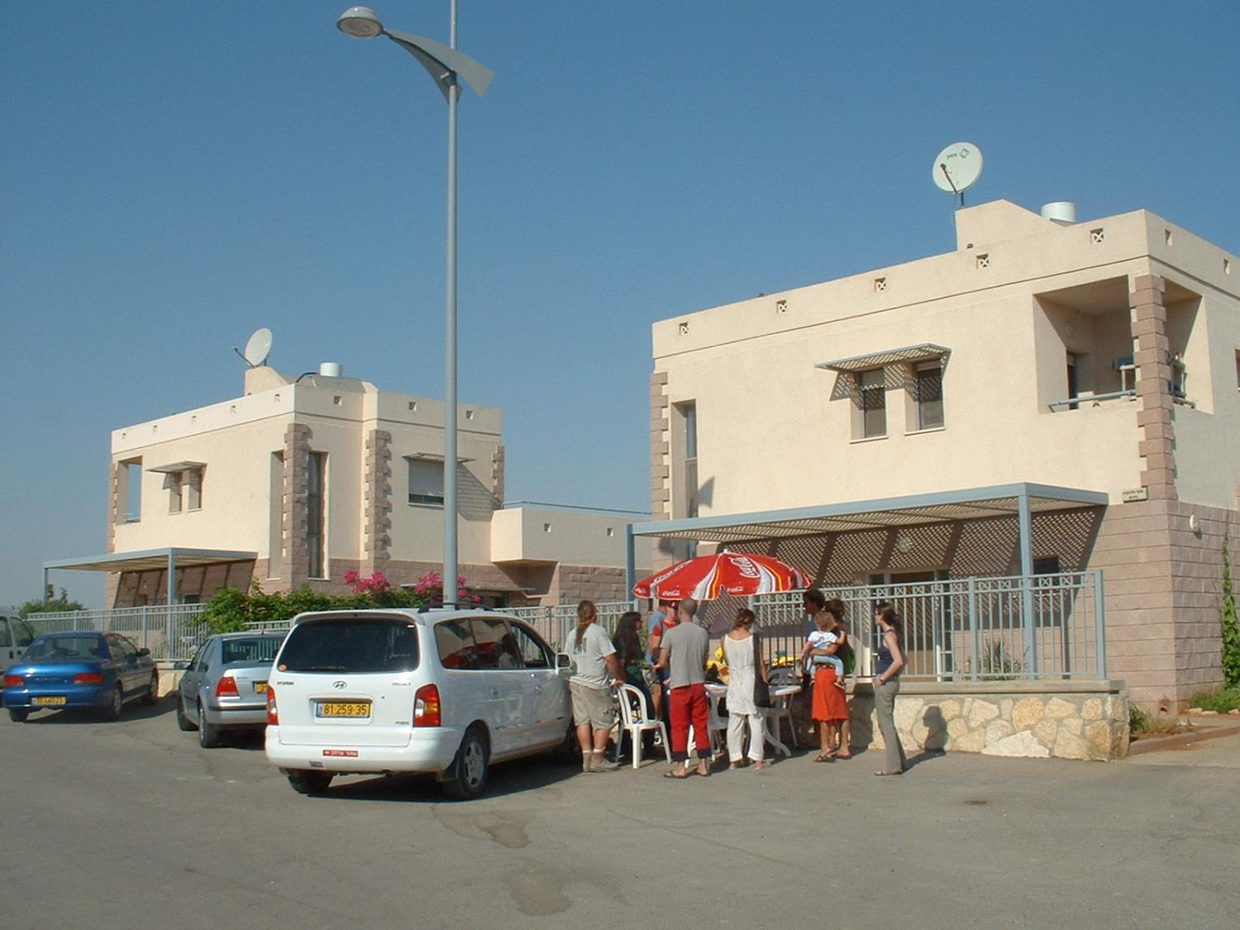
Kibbutz Kalia (pop. 300)
Notes:
Kibbutz Kalia was first established in 1929 on the northern shore of the Dead Sea. It was occupied and destroyed by the Jordanians in 1948 and rebuilt in 1968, after the Six-Day War. The name “Kalia” is a Hebrew acronym which stands for “the Dead Sea comes to life.” Over 300 people now live in Kalia. Major employment is growing dates, a milk dairy, a vineyard and tourism. The kibbutz is also home to the regional elementary school, which serves five other communities in the area.
Photo: http://www.dead-sea.org.il/?CategoryID=225&ArticleID=265&Page=1
Background: http://www.kalia.org.il/עלקליה/היסטוריה/tabid/165/Default.aspx, http://kalia.org.il/עלקליה/מיאנחנו/tabid/168/Default.aspx

Slide 15
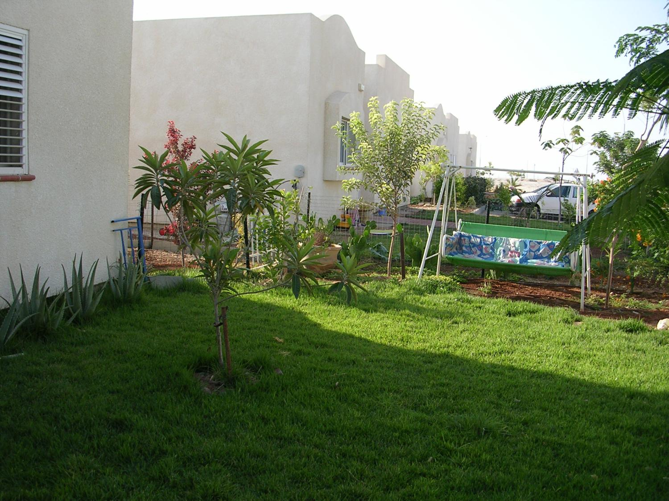
Kibbutz Beit HaArava (pop. 100)
Notes:
Northern Dead Sea, near Jericho
http://kibbutzimofisrael.netzah.org/beit-haarava.php
http://www.dead-sea.org.il/?CategoryID=191&ArticleID=156&Page=1
Photo: http://www.moshavim.net/board-category.php?id=2

Slide 16
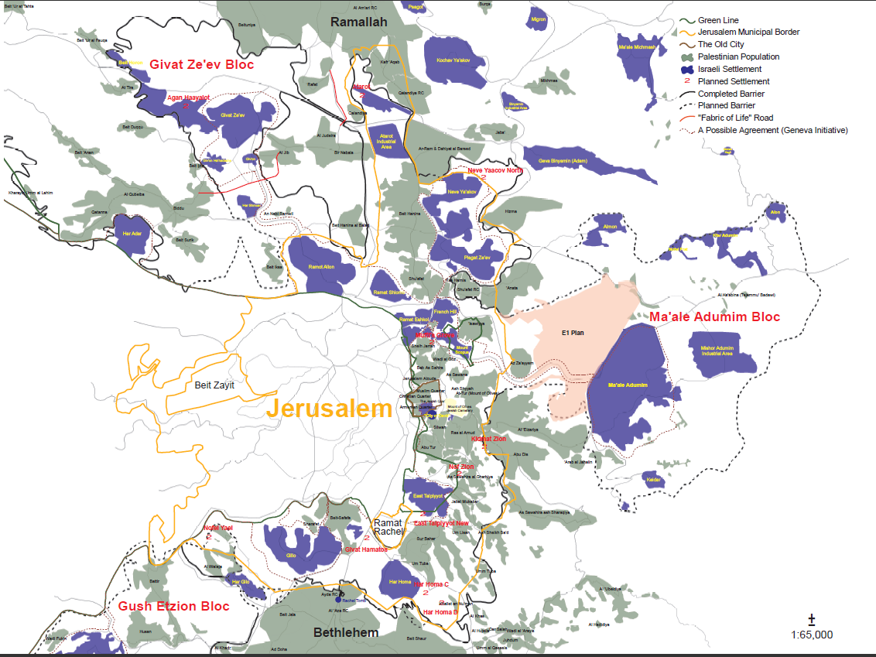
Notes:
Source: Peace Now, http://peacenow.org.il/eng/sites/default/files/JerusalemSideJune2010.pdf, retrieved Feb. 7, 2011
More info: http://www.jewishvirtuallibrary.org/jsource/talking/40_consensus.html

Slide 17
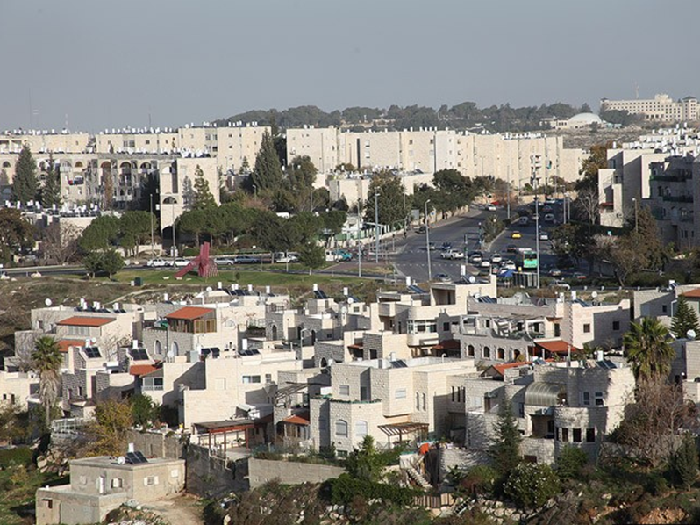
Gilo Neighborhood, Jerusalem
Notes:
Gilo is a Jerusalem neighborhood with a population of around 40,000. The ground was bought by Jews before World War II and settled in 1971 in south west Jerusalem opposite Mount Gilo within the municipal borders.
Photo: http://www.jerusalemshots.com/Jerusalem_en38-13340.html
More information: http://maurice-ostroff.tripod.com/id249.html

Slide 18
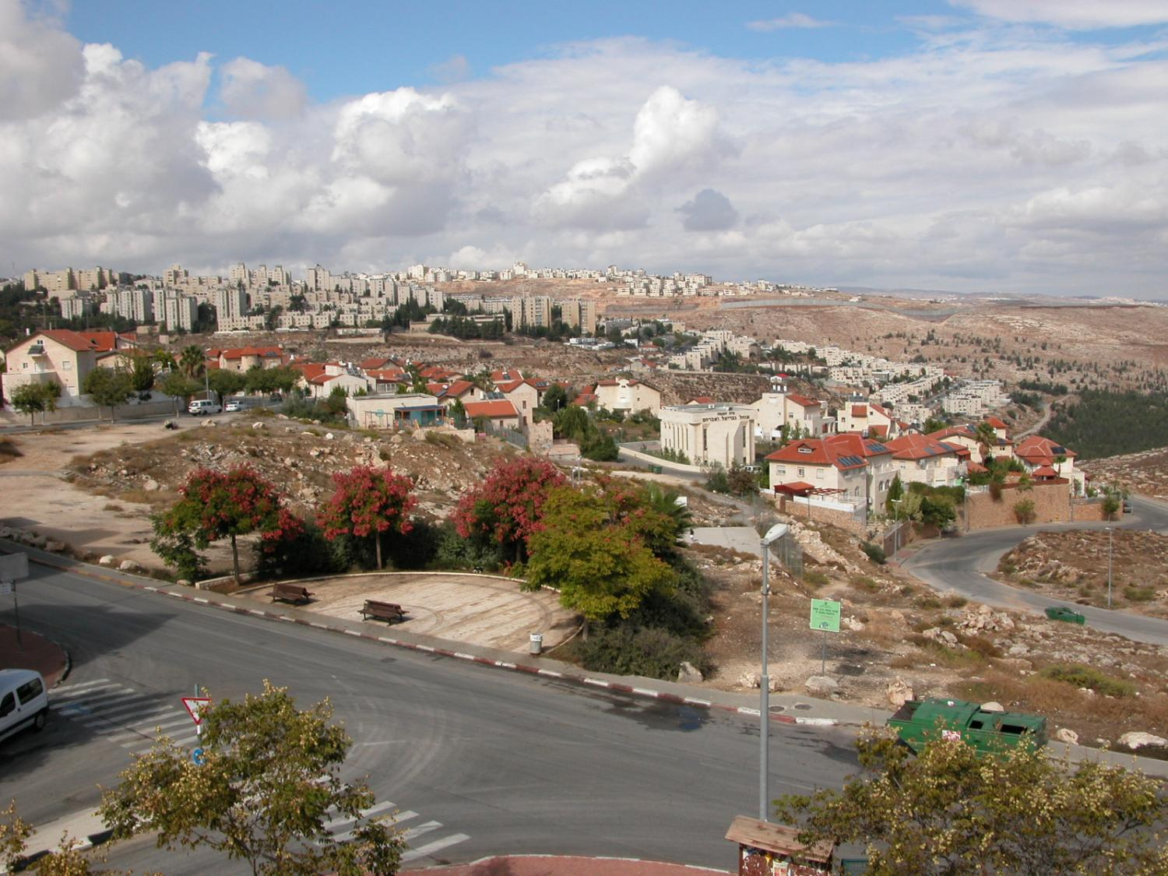
Pisgat Zeev Neighborhood, Jerusalem
Notes:
Pisgat Ze'ev is a residential neighborhood in northeastern Jerusalem, established in 1984. Its current population is about 50,000.
More information:
http://en.wikipedia.org/wiki/Pisgat_Ze%27ev
http://www.jerusalem.muni.il/jer_sys/picture/atarim/site_form_atar_eng.asp?site_id=2277&pic_cat=4&icon_cat=6&york_cat=9&type_id=197
http://www.pisgatzeev.co.il/ (Hebrew)
Photo: http://www.panoramio.com/photo/10561821

Slide 19
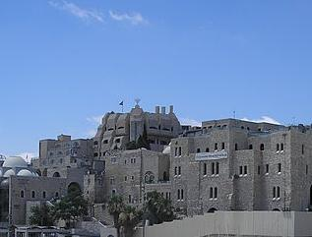
Jewish Quarter, Jerusalem
Notes:
The Jewish Quarter in Jerusalem’s old city has had a nearly continual Jewish presence since the eighth century BCE. At the turn of the 20th century the Jewish population of the quarter reached 19,000.
In 1948 during the War of Independence, its population of about 2,000 Jews was besieged and continually attacked. After 13 days of fighting, the Quarter’s 30 defenders surrendered to the Jordanian Arab Legion. They, together with 50 wounded and 260 civilians, ranging in age from 13 to 78, were taken into captivity. The Jordanian Arab Legion proceeded to destroyed the Quarter’s buildings. They blew up the Hurva Synagogue, originally built in 1701, and razed or pillaged and stripped fifty one other Jewish synagogues and houses of worship, later converted to house livestock.
Israel reclaimed the Quarter, and the rest of Jerusalem’s old city, in the 1967 Six-Day War. The Quarter was rebuilt in the late 1970s and the 1980s and today has a Jewish population of over 2,500. The Quarter is also the site of the Western Wall, a remnant of the Second Temple’s external wall, where thousands of Jews come every day to pray
Photo: http://en.wikipedia.org/wiki/File:Tankizyya_P6070044.JPG
http://www.jewish-quarter.org.il/

Slide 20
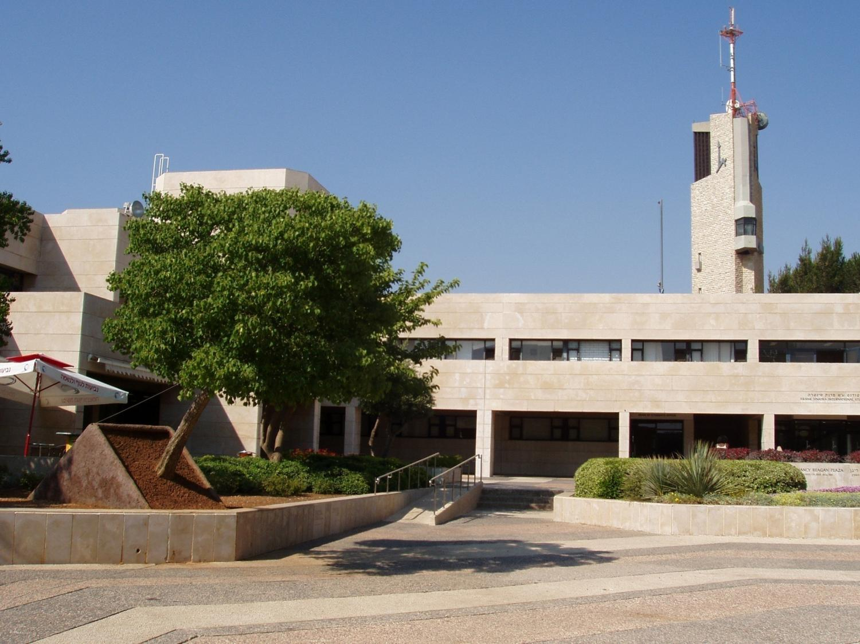
Hebrew University of Jerusalem
Mount Scopus Campus
Notes:
The cornerstone for the Hebrew University campus on Mount Scopus was laid in 1918 and the opening ceremony took place at a gala ceremony seven years later, on April 1, 1925. By 1947, the University had become a large research and teaching institution with over 1,000 students and 200 faculty members.
During the 1948 Arab-Israeli War, the Arabs repeatedly attacked convoys moving between the Israeli-controlled section of Jerusalem and the University. In April 1948 a medical convoy to the nearby Hadassah hospital was ambushed and 79 doctors and nurses were murdered. Mount Scopus campus was cut off from Jewish Jerusalem. In the 1949 Armistice Agreements, Mount Scopus became controlled by Jordan, which refused Israeli access to the campus for its 19-year occupation of the area.
After the unification of Jerusalem in 1967, the University returned to and rebuilt the Mount Scopus campus. The construction work was completed in 1981, and Mount Scopus again became the main campus of the University. Today it houses the Faculties of Humanities, Social Sciences, and Law; the schools of Business Administration and Social Work; the Harry S. Truman Research Institute for the Advancement of Peace, Rothberg International School and Mandel Institute of Jewish Studies.
There are about 23,000 undergraduate and graduate students at the Hebrew University, including Israeli Jews and Arabs as well as international students. Notable alumni include 5 Nobel laureates, 3 former presidents of Israel and 3 of its former prime ministers.
KEY POINT: The university was founded over 90 years ago, established and attended by Jews in pre-state Palestine and now in Israel. For all of its history, except for a 19-year illegal occupation by Jordan (1948-1967), it was a Jewish institution of research and higher learning. Under any reasonable definition, this area cannot possibly be considered “occupied Palestinian land”!
Sources:
http://en.wikipedia.org/wiki/Hebrew_University_of_Jerusalem
http://www.huji.ac.il/huji/eng/aboutHU_e.htm
Photo: http://en.wikipedia.org/wiki/File:HebrewU-MtScopus.JPG

Slide 21
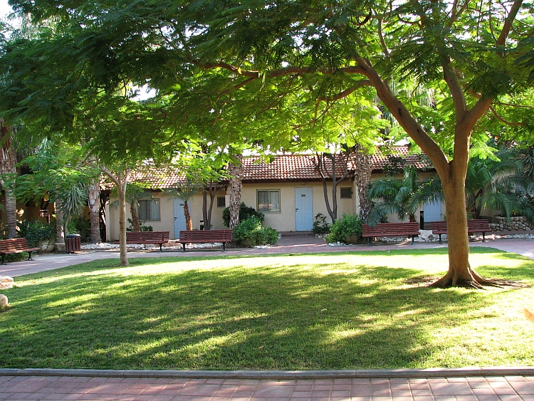
Outpost: Almog (pop. 150)
Notes:
Almog is a kibbutz near the northwestern shores of the Dead Sea, near Jerico. It was founded in 1977 and has a population of about 150 people. It is considered an “outpost,” i.e., east of the Security Fence, not adjacent to the “Green Line” (1949 Armistice Line) and not part of the major settlement blocs.
Sources
http://en.wikipedia.org/wiki/Almog
http://settlementsofisrael.netzah.org/almog.php
http://www.dead-sea.org.il/?CategoryID=198&ArticleID=157&Page=1 [Hebrew]
Israel Central Bureau of Statistics, http://cbs.gov.il/ishuvim/ishuv2009/bycode.xls (codes: מחוז ונפה=71 through 77, index at http://cbs.gov.il/ishuvim/ishuv2009/index2009.xls)
Location (east or west of Security Fence) and area: http://peacenow.org.il/eng/sites/default/files/Breaking_The_Law_formal%20data_March07Eng.pdf
Photo: http://en.wikipedia.org/wiki/File:AlmoganS.jpg

Slide 22
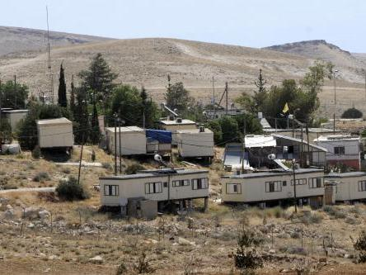
Outpost: Kfar Eldad
Notes:
Israeli outpost Kfar Eldad in Gush Etzion
Kfar Eldad is located in the Judean Mountains, overlooking the Judean Desert. It was founded in 1994 and has a population of 14 families.
Source: http://settlementsofisrael.netzah.org/kfar-eldad.php
Photo: http://www.upi.com/News_Photos/News/West-Bank-Settlement-Expansion/1971/18/ June 1, 2009. (UPI Photo/Debbie Hill)

Slide 23
II. Why Were the Settlements Built?

Slide 24
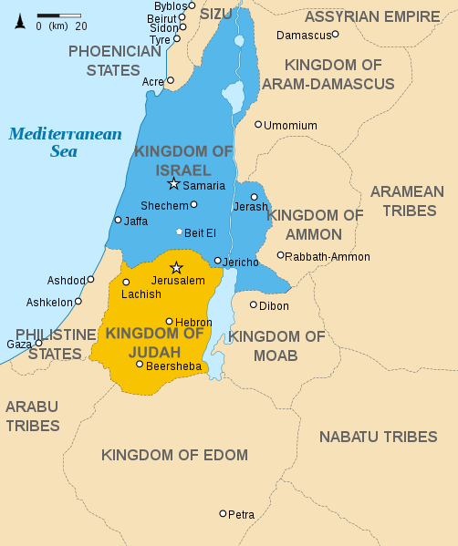
Historical & Religious
Connection
9th c. BCE
Notes:
Map: http://en.wikipedia.org/wiki/File:Kingdoms_of_Israel_and_Judah_map_830.svg
Jewish presence in the regions of Judea and Samaria, today’s West Bank, did not start in 1967 or 1880. These places have deep roots in Jewish tradition and culture, and places of historical and religious significance. The word “Jew” derives from the region of Judah, or Judea, where the people of Israel settled over three thousand years ago. Many sites and cities in the West Bank have biblical and religious attachment for observant and traditional Jews, including:
Hebron is the site of the Cave of Machpelah, the burial site of the Patriarchs (Genesis 23:1-20, 25:9, 49:29-30, 50:12-13). The Cave still exists today and is the second holiest Jewish site, after the Temple Mount in Jerusalem.
Beit El (Bethel) was the site of Jacob’s dream about angels coming up and down a ladder (Genesis 28:19).
Shechem (Nablus): In the Biblical narrative, Abraham traveled through Shechem and built an altar there (Genesis 12:6-8). Later Abraham’s grandson Jacob bought a nearby plot and set up another alter (Genesis 33:18-20). Jacob’s sons fought Shechem in retaliation for his rape of their sister Dinah (Genesis 34). The city was later captured, apparently without a fight, by Joshua, and inhabited by Israelites (Joshua 8; 24). It was mentioned by King David (Pslam 60:6-8; 108:7-9) and became the capital of the Northern Kingdom of Israel under King Jeroboam (1 Kings 12:25) until its destruction during the reign of Menahem around 740 BCE (2 Kings 15:13-16).
Jericho is known in the biblical tradition as the place of the Israelites' entry into Canaan when Joshua led them back from bondage in Egypt (Joshua 4).
Samaria was the capital of the Kingdom of Israel during the reign of Omri (c. 884 BCE) who purchased the hill and built the city (1 Kings 16:23-24).

Slide 25
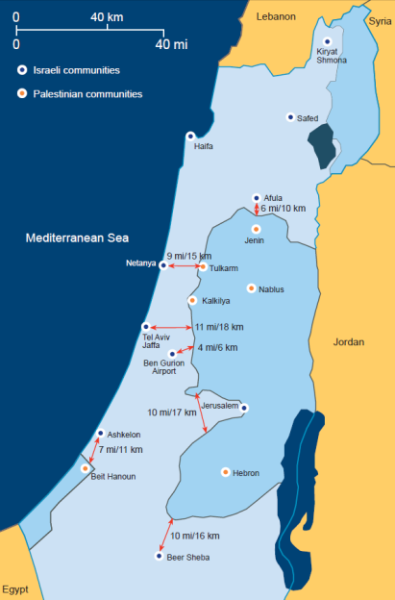
Security Considerations
Notes:
Map: http://www.bicom.org.uk/context/maps/threats-and-topography/israel-s-narrow-waistline

Slide 26
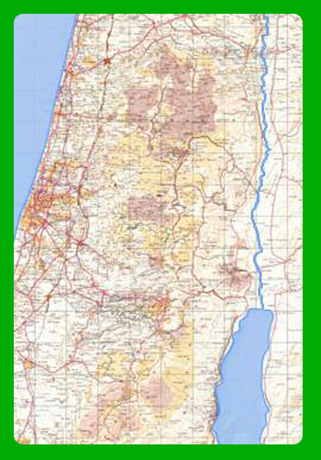
Highway #6
Kfar-Sava
Qalqilya
• Qalqiliya
Tel
Aviv
•
Highway #6
Notes:
Source: Israeli Ministry of Foreign Affairs, http://www.mfa.gov.il/NR/rdonlyres/C408D82F-9365-439A-A17B-A2BE418A618E/0/AntiTerroristFence.pps, slide #16

Slide 27
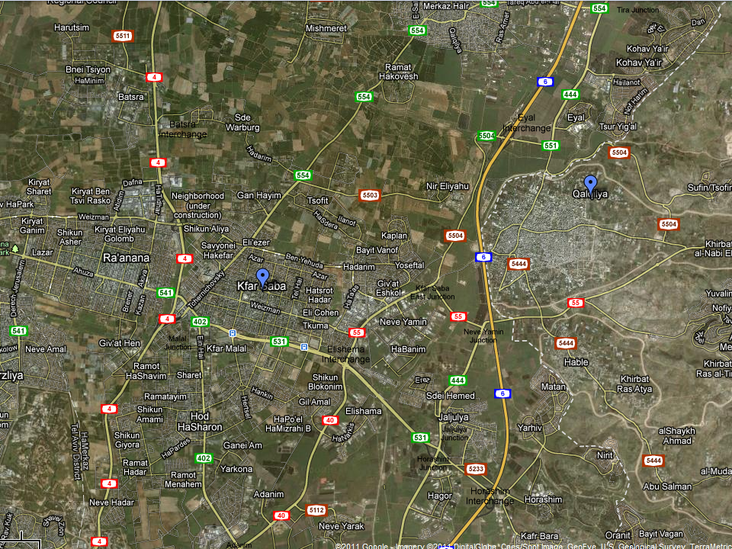
Qalqilya
Kfar Saba
1 mi
2 km
Notes:
Google Maps, http://is.gd/vuVRSy

Slide 28
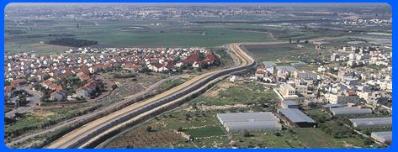
Habla
Palestinian Authority
Matan
Israel
Notes:
Source: Israeli Ministry of Foreign Affairs, http://www.mfa.gov.il/NR/rdonlyres/C408D82F-9365-439A-A17B-A2BE418A618E/0/AntiTerroristFence.pps, slide #17

Slide 29
III. Are Settlements Illegal?
Notes:
Seems like an absurd question: Shouldn’t anybody be allowed to live anywhere? Jews, after all, lived in the Land of Israel thousands of years ago, and have simply reclaimed their ancestral homeland. Surely they have a stronger claim to the land than, say, the Anglo-Saxons have to England or the English to North America and Australia. But still, some see this issue as contentious or debatable, so we’ll take the time here to describe the legal basis for Jewish settlements in the West Bank, which is well supported in international agreements.

Slide 30
III. Are Settlements Illegal?
Balfour Declaration (1917)
San Remo Conference (1920)
Mandate for Palestine (1922)
Israel’s Declaration of Independence (1948)
Fourth Geneva Convention (1949)
Notes:
Some people contend that Jews living in West Bank communities are a violation of “international law.” This is patently absurd; anywhere else in the world, if someone didn’t allow Jews or Christians or Muslims or Sikhs to live, we’d shout “discrimination.” Yet the idea that Jews cannot live in some parts of their historic homeland is somehow acceptable to liberals??
Still, we can and should examine the legality of Jewish settlements in the West Bank. Those who say such settlements are illegal usually fail to cite any applicable law, with one occasional exception. Let’s examine the relevant legal documents that establish the rights of Jews to live anywhere in historic Palestine, and the one document that’s cited—incorrectly—to prove the anti-settlement case. These documents date back almost 100 years, to the establishment of a British Mandate, or trust, in the Palestine region of the former Ottoman Empire after World War I.

Slide 31
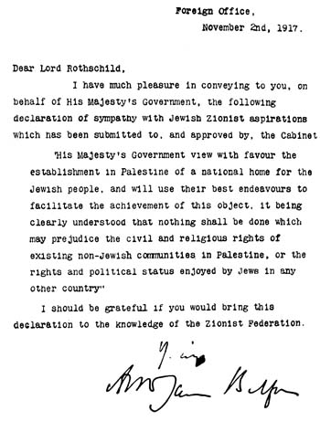
Balfour Declaration (1917)
Notes:
The first modern-day international recognition of Jewish rights was during the latter part of World War I, when the British were about to conquer lands in the Middle East then held by the Ottoman Empire. British Foreign Secretary Arthur James Balfour sent an official letter to Baron Walter Rothschild, a leader of the British Jewish community, for transmission to the Zionist Federation of Great Britain and Ireland. The letter, known as the “Balfour Declaration,” reflected the position of the British Cabinet, and its desire to express “sympathy with Jewish Zionist aspirations.” Zionism was the national movement of the Jewish people, which aimed to reunite the Jews with their historical homeland and, ultimately, to establish Jewish sovereignty in the Land of Israel.
Source: http://en.wikipedia.org/wiki/Balfour_Declaration_of_1917

Slide 32

San Remo Conference (1920)
“…The High Contracting Parties agree to entrust, by application of the provisions of Article 22, the administration of Palestine, within such boundaries as may be determined by the Principal Allied Powers, to a Mandatory, to be selected by the said Powers. The Mandatory will be responsible for putting into effect the declaration originally made on November 8, 1917, by the British Government, and adopted by the other Allied Powers, in favour of the establishment in Palestine of a national home for the Jewish people, it being clearly understood that nothing shall be done which may prejudice the civil and religious rights of existing non-Jewish communities in Palestine, or the rights and political status enjoyed by Jews in any other country.”
Notes:
The San Remo Conference was an international meeting of the post-World War I Allied Supreme Council, held in Sanremo, Italy, in April 1920. It was attended by the four Principal Allied Powers of World War I: the prime ministers of Britain, France, and Italy, and Japan’s ambassador. These Allies allocated “mandates” for administration of the former Ottoman-ruled lands of the Middle East according to Article 22 of the Covenant of the League of Nations. The resolution repeats the language of the Balfour Declaration, favoring “the establishment in Palestine of a national home for the Jewish people.” It did not specify the borders of the territories or of the “national home,” and was intended and interpreted at the time to mean the entire Mandate area, which includes today’s Israel, including the West Bank and Gaza, as well as Jordan.
Source: http://en.wikipedia.org/wiki/San_Remo_conference

Slide 33
British Mandate for Palestine (1922)
Whereas the Principal Allied Powers have also agreed that the Mandatory should be responsible for putting into effect the declaration originally made on November 2nd, 1917 […] in favor of the establishment in Palestine of a national home for the Jewish people, […]
Whereas recognition has thereby been given to the historical connection of the Jewish people with Palestine and to the grounds for reconstituting their national home in that country [….]
Article 6. The Administration of Palestine, while ensuring that the rights and position of other sections of the population are not prejudiced, shall facilitate Jewish immigration under suitable conditions and shall encourage, in co-operation with the Jewish agency referred to in Article 4 [the Zionist organization], close settlement by Jews on the land, including State lands and waste lands not required for public purposes.
Notes:
The British Mandate for Palestine was the legal commission for the administration of Palestine, confirmed by the Council of the League of Nations on July 24, 1922. The document was again based on the Article 22 of Covenant of the League of Nations and the San Remo Resolution, and referenced the Balfour Declaration of 1917 regarding “the establishment in Palestine of a national home for the Jewish people.” Article 6 of the Mandate explicitly stated that the British administration will facilitate Jewish immigration and settlement on the land.
In September 1922, Britain split the Mandate into two administrative parts: the part west of the Jordan River, 23% of the entire territory, became known as "Palestine", and the part east of the Jordan, 77% of the entire territory, as "Transjordan." In the Transjordan Memorandum the British administration stated that the Jewish “national home” will not include Transjordan.
In 1924, the U.S. and British governments signed the Anglo-American Convention, in which the U.S. fully accepted the Mandate for Palestine, declaring all of the West Bank within its borders.
Text of the Mandate: http://avalon.law.yale.edu/20th_century/palmanda.asp
More information: http://en.wikipedia.org/wiki/Palestine_(mandate)
Transjordan Memorandum: http://en.wikipedia.org/wiki/Transjordan_memorandum
Anglo-American Convention: http://myrightword.blogspot.com/2009/11/that-anglo-american-convention-of-1924.html, http://www.justicenow4israel.com/anglo-american.html

Slide 34
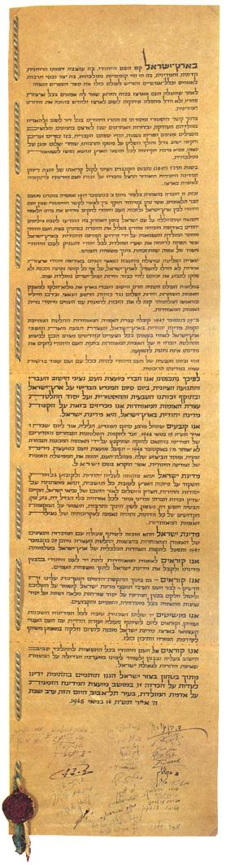
Israel’s Declaration of Independence (1948)
“The Land of Israel was the birthplace of the Jewish people. [….] After being forcibly exiled from their land, the people kept faith with it throughout their Dispersion and never ceased to pray and hope for their return to it and for the restoration in it of their political freedom. [....] Jews strove in every successive generation to re-establish themselves in their ancient homeland. In recent decades they returned in their masses […] and created a thriving community controlling […] aspiring towards independent nationhood.
“[T]he right of the Jewish people to national rebirth in its own country […] was recognized in the Balfour Declaration of the 2nd November, 1917, and re-affirmed in the Mandate of the League of Nations which, in particular, gave international sanction to the historic connection between the Jewish people and Eretz-Israel and to the right of the Jewish people to rebuild its National Home. [….]
“On the 29th November, 1947, the United Nations General Assembly passed a resolution calling for the establishment of a Jewish State in Eretz-Israel [….] The right of the Jewish people to establish their State […] is the natural right of the Jewish people to be masters of their own fate, like all other nations, in their own sovereign State. [….]
“We appeal to the Jewish people throughout the Diaspora to rally round the Jews of Eretz-Israel in the tasks of immigration and upbuilding and to stand by them in the great struggle for the realization of the age-old dream - the redemption of Israel.”
Notes:
http://www.knesset.gov.il/docs/eng/megilat_eng.htm

Slide 35
Fourth Geneva Convention (1949)
Art. 2. [T]he present Convention shall apply to all cases of declared war or of any other armed conflict which may arise between two or more of the High Contracting Parties […]
The Convention shall also apply to all cases of partial or total occupation of the territory of a High Contracting Party [….]
Applies to occupation of another nation’s territory
Does not apply to the West Bank!
  There has never been an independent Palestinian state
  The area has not been under legal Arab sovereignty for over 1,000 years
  It was illegally occupied by Jordan (1949-1967)
  Jordan explicitly renounced any claim in 1988
Notes:
http://www.icrc.org/ihl.nsf/INTRO/380?OpenDocument
First, what is the Geneva Convention? It’s an international treaty between states, with 194 “state parties.” Israel signed the Convention as did its neighbors, Jordan, Egypt, Syria, and Lebanon. It was not signed by the Palestinians, since they were not then and are not now an independent state that can be a party to international treaties.
The Convention applies to wars between Contracting Parties and occupation by one Contracting Party of another’s territory. But Egypt never annexed or claimed the Gaza Strip, and the West Bank was never internationally recognized as Jordanian territory. Moreover, both Egypt and Jordan expressly disclaimed any rights to the respective territories in their peace treaties with Israel, Egypt in 1979 and Jordan in 1994. So there really is no “occupation of the territory of a High Contracting Party” to which the Fourth Geneva Convention would apply.

Slide 36
Fourth Geneva Convention (con’t)
Article 49 (6). An occupying military power “shall not deport or transfer part of its own civilian population into the territory it occupies.”
Israel has not “deported” or “transferred” anyone into the West Bank
Settlement residents live there by their own choice
Applies to forceful relocation, not voluntary migration!
Notes:
Even if the Convention did apply, it doesn’t say anything about voluntary civilian settlement. Article 49(6) states that an occupying military power "shall not deport or transfer part of its own civilian population into the territory it occupies." So even if you consider Israel to be an “occupying power” under the convention, Israel has never “deported” or “transferred” its population to the settlements. Jews are living in West Bank community under their own free will!

Slide 37
Legal Status of the West Bank
Technically, an “unallocated portion of the British Mandate” territory
Jews have the legal right to settle anywhere between the Jordan River & Mediterranean
The Fourth Geneva Convention
  Does not apply to the West Bank
  Does not apply to voluntary migration
“Israel has an unassailable right to establish settlements in the West Bank.” –Eugene Rostow
Notes:
References:
http://www.think-israel.org/green.sanremo.html
http://theisraelisettlements.blogspot.com/p/settlements-legal-issues.html
http://www.takeapen.org/Takeapen/Templates/showpage.asp?DBID=1&LNGID=1&TMID=84&FID=997
http://www.think-israel.org/mehlman.griefbook.html
http://myrightword.blogspot.com/2009/11/that-anglo-american-convention-of-1924.html
Eugene Rostow, a former dean of Yale Law School, a leading interpreter of international law, an undersecretary of state for political affairs in the American State Department, and an author of Resolution 242, argued that, under the League of Nations Mandate for Palestine and under article 80 (the so-called "Palestine article") of the United Nations Charter, Jews have a right to settle in any of the land between the Jordan and the Mediterranean.

Slide 38
IV. Are Settlements an Obstacle to Peace?

Slide 39
IV. Are Settlements an Obstacle To Peace?
There was no peace before 1967, when the West Bank was occupied by Jordan
There was no peace from 1967 to 1983, when there were very few West Bank settlements
There is no peace with Gaza, where Israel withdrew & evacuated its settlements in 2005
There is peace with Egypt and Jordan, despite settlements
Notes:
Israel captured the West Bank in the 1967 Six-Day War, ending 19 years of Jordanian occupation. Before 1967, Israel didn’t rule West Bank and there were no Jews living there—yet Israel did not have peace with the Palestinians, Jordan, or any of its other Arab neighbors. From 1967 to 1983, there were virtually no Jewish communities in the West Bank and Gaza—yet Israel did not have peace.
In 1980, as part of its peace treaty with Egypt, Israel withdrew from the Sinai Peninsula, dismantled settlements, and evacuated its civilian population from communities along the Mediterranean coast (e.g., Yamit) and the Red Sea (e.g., Nevi’ot).
In August 2005, Israel withdrew from the Gaza Strip, evacuating 8,000 Israelis from 27 towns and communities, in a highly divisive and traumatic event in Israeli history. Following the withdrawal, the Iranian-backed terrorist group Hamas violently took control of the Gaza Strip and began launching mortars and rockets at southern Israel. The Gaza withdrawal did not bring the hoped-for peace, even though settlements were removed.
Today, the Palestinian economy is booming, and the Palestinian population of the West Bank is thriving, despite the settlements.

Slide 40
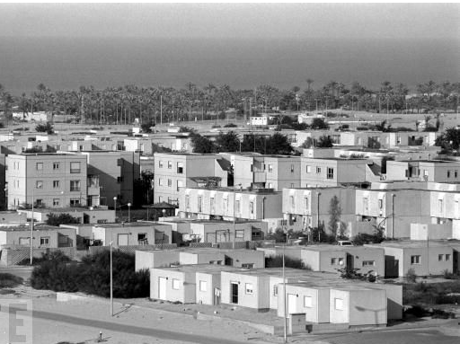
Yamit (evacuated 1982)
Notes:
Yamit was an Israeli settlement in the northern Sinai Peninsula. It was home to about 2,500 people until it was handed over to Egypt in 1982 according to the terms of the 1979 Israel-Egypt Peace Treaty.
Photo: http://www.life.com/image/52980973
More information: http://www.jewishvirtuallibrary.org/jsource/Peace/yamit.html

Slide 41
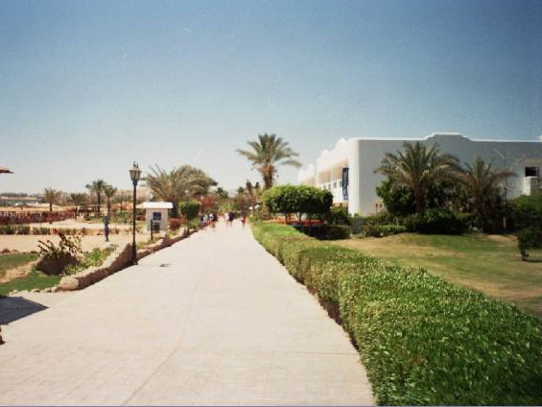
Ofira (evacuated 1982)
Notes:
Ofira (Hebrew: אופירה‎) was an Israeli settlement in the Sharm el-Sheikh area of the southern Sinai Peninsula, an Egyptian territory that was under Israeli occupation from 1967 to 1982. Ofira was settled from 1969, and was meant to accommodate 500 families. An airfield was opened in 1976, today known as Sharm el-Sheikh International Airport.
Photo: http://www.holylandmap.net/PhotoAlbums/SinaiOD/slides/10%20-%20Ofira%20Promenade.html

Slide 42
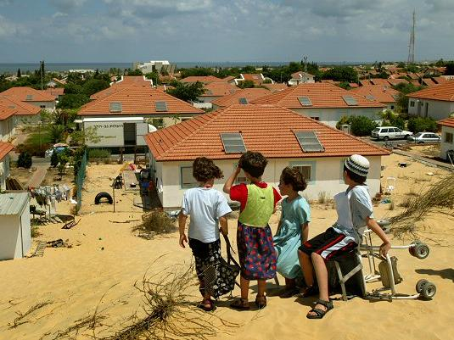
Neve Dekalim (evacuated 2005)
Notes:
Photo: http://www.israeltoday.co.il/Portals/0/092005nevedekalimkidsview.jpg

Slide 43
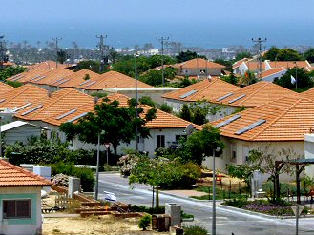
Kfar Darom (evacuated 2005)

Slide 44

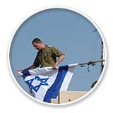
A Painful Sacrifice
Notes:
Bottom right: Soldier and settler embrace
http://cache1.asset-cache.net/xc/53392049.jpg?v=1&c=IWSAsset&k=2& d=77BFBA49EF878921F7C3FC3F69D929FDE837B27459528BA60262FBDFE8B7DD40CA22D82D8FA7987AB01E70F2B3269972
Israeli soldier folding flag, as last homes are evacuated

Slide 45
What Will Happen To the Settlements
Under a Future “Two-State Solution”?
When a Palestinian state is established, West Bank Jewish communities may be….
Incorporated into Israel
  With land swap?
Remain in Palestine
Be evacuated and removed

Slide 46

Incorporated Into Israel?
Letter from President George W. Bush to Israeli Prime Minister Ariel Sharon, April 2004:
  “In light of new realities on the ground, including already existing major Israeli populations centers, it is unrealistic to expect that the outcome of final status negotiations will be a full and complete return to the armistice lines of 1949…”
Notes:
http://www.mfa.gov.il/MFA/Peace+Process/Reference+Documents/Exchange+of+letters+Sharon-Bush+14-Apr-2004.htm
“As part of a final peace settlement, Israel must have secure and recognized borders, which should emerge from negotiations between the parties in accordance with UNSC Resolutions 242 and 338. In light of new realities on the ground, including already existing major Israeli populations centers, it is unrealistic to expect that the outcome of final status negotiations will be a full and complete return to the armistice lines of 1949, and all previous efforts to negotiate a two-state solution have reached the same conclusion. It is realistic to expect that any final status agreement will only be achieved on the basis of mutually agreed changes that reflect these realities.”
Under one set of proposals, the major settlement blocs will be annexed to Israel, and Israel will cede to the Palestinian state an equivalent amount of land in unpopulated areas. This idea, referred to as the “land-swap” option, has been generally accepted by the Palestinians, though the specifics have not been agreed to.
References:
http://www.jpost.com/MiddleEast/Article.aspx?id=176148)
http://english.aljazeera.net/palestinepapers/2011/01/2011122114239940577.html

Slide 47
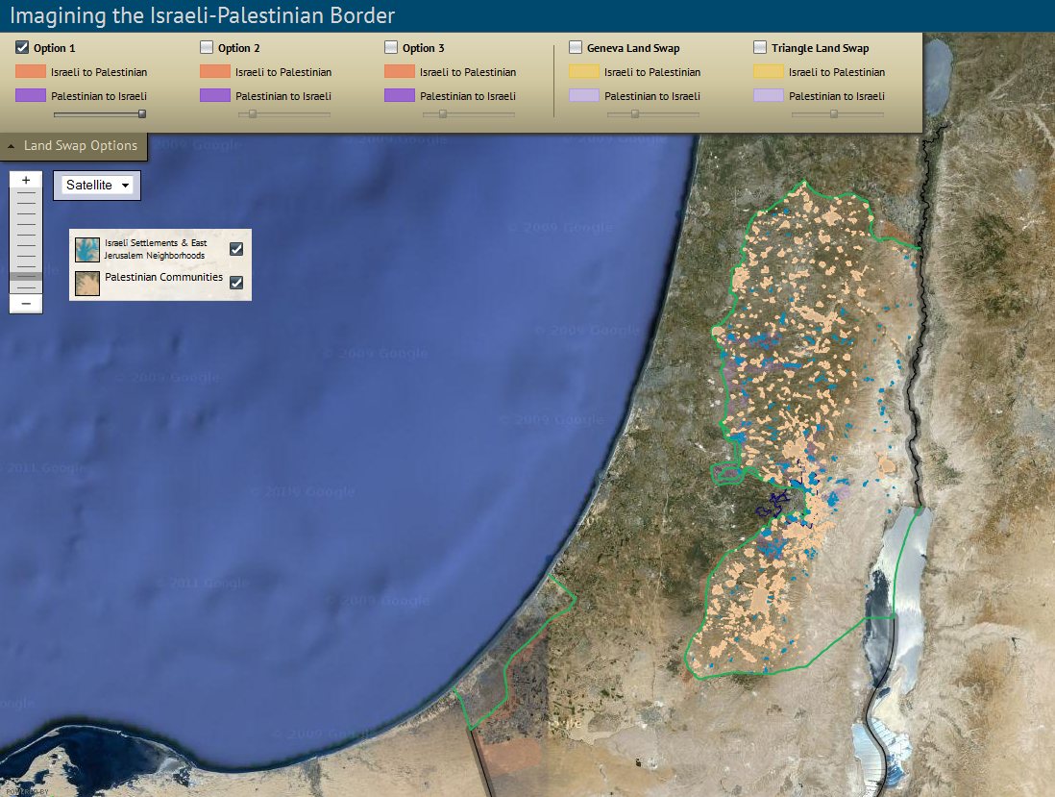
Land Swaps?
Notes:
A think-tank called the Washington Institute for Near East Policy published in January 2011 a report by David Makovsky titled “Imagining the Border: Options for Resolving the Israeli-Palestinian Territorial Issue.” Through detailed maps and in-depth population data, Makovsky shows how the parties can use land swaps to meet some of their most important goals, such as minimizing dislocation, ensuring security, and establishing a contiguous Palestinian state in the West Bank. An online interactive map allows users to explore the report's various land swap proposals and see detailed information about every Israeli and Palestinian community in the West Bank. Using Google Earth data and images, users can examine the land-swap proposals from a local perspective, down to the level of individual streets and buildings.
Sources:
http://washingtoninstitute.org/templateC04.php?CID=301
http://washingtoninstitute.org/interactiveMaps/imap.php

Slide 48
Remain in a Future Palestine?
Many examples of ethnic minorities in nation-states, usually in and near border regions
  2 million Hungarians in Romania
  >1 million Germans in Russia
  800,000 Turks in Bulgaria
  >1.5 million ethnic Albanians in Kosovo
1.5 million Palestinian Arabs are Israeli citizens
Jews should be allowed to remain in Palestine

Slide 49
Evacuated?
Yamit 1982
Ofira 1982
Neve Dekalim 2005
Kfar Darom 2005

Slide 50
Summary
Judea and Samaria are the cradle of Jewish civilization, with deep religious significance
Settlements are Jewish cities, towns and communities in the West Bank
Settlements are politically contentious, but not illegal
Settlements are not an obstacle to peace
Settlements do not preclude the establishment of a future Palestinian state

Slide 51


