Slide 1
A Positive Note

Slide 2
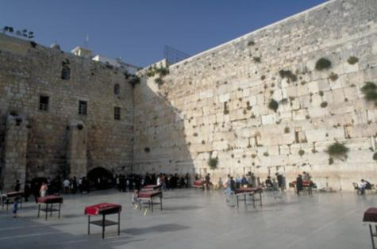
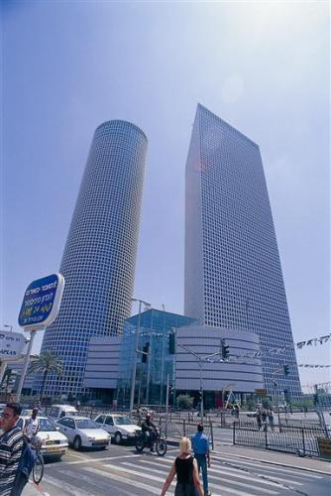
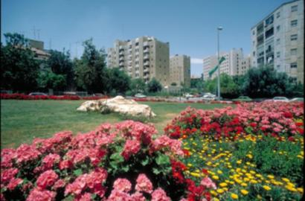
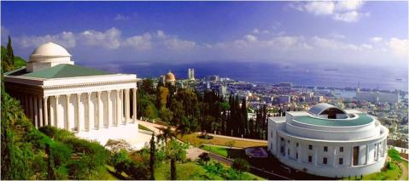
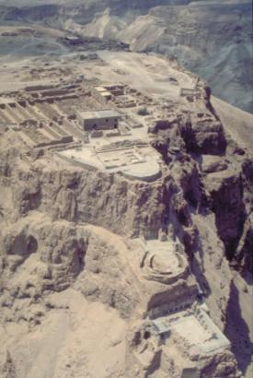
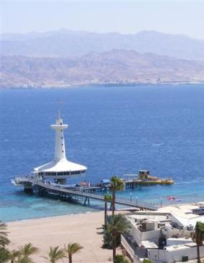
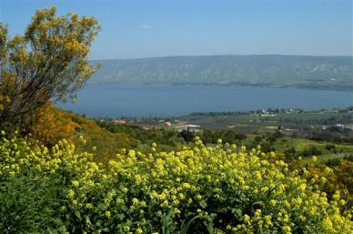
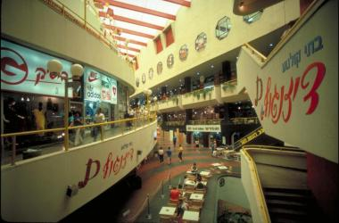
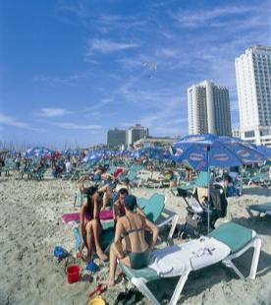

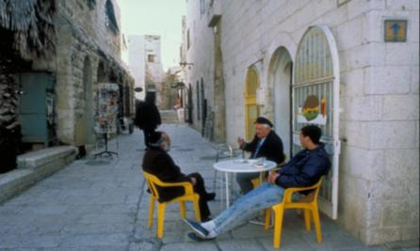

Notes:
In Israel, you’ll find ancient structures, attesting to Jewish civilizations from thousands of years ago (the Kotel or Western Wall, top left, and Masada, middle row, second from the left) , and gleaming 21st Century high-tech high-rises (top row, middle picture).
In Jerusalem, Israelis live in modern apartment buildings (upper right), and also in the restored ancient Jewish Quarter (bottom row, third from the left). They do their shopping at an open-air produce market (bottom right) or a snazzy mall (above it).
The Mediterranean beaches (bottom left) attract locals and tourists in nice weather, which is most of the year; in Eilat, on the shore of the Red Sea, there’s an underwater observatory (leftmost, middle picture)—kind of like an aquarium, only the people are in the glass room and the fish are in their natural habitat—and some of the best scuba diving in the world.
Haifa, a port city on the Mediterranean Sea, is home to a Baha’i temple (rightmost, second from top).

Slide 3
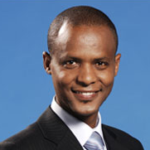











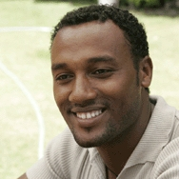


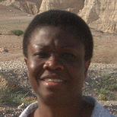
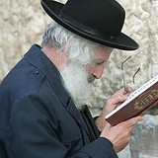
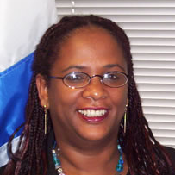


Notes:
Top row, left: Elias Inbram, Ethiopian-born Israeli diplomat, now on his first assignment to South Africa. Inbram was 8 years old when his family walked from Ethiopia to Sudan (where he saw a white person for the first time, and assumed the person had some sort of skin disease). When they later arrived in Israel, he saw many white people, and learned to accept that they were Jews like him, just with a different skin color….
Top row, second from right: Salim Joubran, Israeli Supreme Court justice (http://elyon1.court.gov.il/heb/cv/fe_html_out/judges/k_hayim/106795700.htm)
Top row, right: Karnit Goldwasser, wife of Ehud Goldwasser, kidnapped in July 2006 by Hezbollah in a cross-border raid from Lebanon (http://www.powerlineblog.com/archives/014884.php)
Second row, right: Prof. Robert Aumann (pronounced awe-mun) of the Hebrew University of Jerusalem, winner of the Nobel Prize in economics for 2005 (http://nobelprize.org/nobel_prizes/economics/laureates/ 2005/index.html). Aumann is the fourth Israeli Nobel Prize winner in four years, joining Prof. Daniel Kahneman (Economics 2002) and Profs. Avram Hershko and Prof. Aaron Ciechanover (Chemistry 2004).
Third row, left: Ilan Ramon, Israel’s first astronaut, killed along with six American colleagues when the space shuttle Columbia broke apart on re-entry in 2003 (http://www.jsc.nasa.gov/Bios/PS/ramon.html)
Third row, middle: Tal Checal, chairman, Ethiopian Student Union in Israel (http://www.jewishagency.org/ JewishAgency/English/Home/About/Press+Room/Jewish+Agency+In+The+News/2005/2005b/aug28ujc.htm+10.htm)
Third row, right: Arab-Israeli Rana Raslan, 21, from Haifa, Miss Israel 1999 (http://news.bbc.co.uk/2/hi/middle_east/294051.stm)
Bottom row, middle: Ethiopian-born Belaynish Zevadia, Israel's deputy consul general to the U.S. Southwest in Houston (http://www.utsa.edu/today/2006/09/zevadia.cfm)
Bottom row, right: Eitan Wertheimer, Chairman of the Board, ISCAR (Israeli metalworking company sold to Warren Buffet in April 2006 for $4B, Buffet’s first-ever investment outside the U.S. (http://www.businessweek.com/globalbiz/content/may2006/gb20060508_953503.htm)

Slide 4
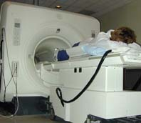

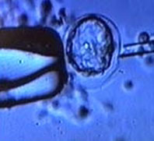

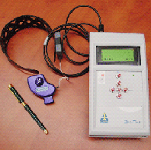
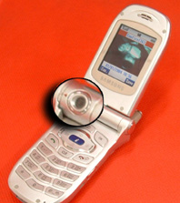
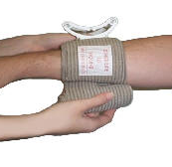

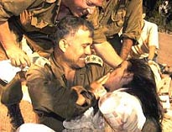
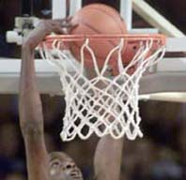
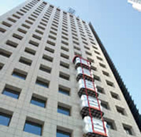
Notes:
[Click on the top-left MRI image for embedded video, Invest-In-Israel.wmv, 7’30”]
Medical Research and Technology
The FDA has approved a new Israeli technique that lets doctors distinguish between malignant tumors and benign lumps of the breast and prostate using MRI scanning instead of cutting, reducing the need for surgical biopsies.
Tel-Aviv based Brainstorm Cell Therapeutics has developed a novel therapy to treat Parkinson’s Disease, using bone marrow cells to produce dopamine, the chemical that is missing in Parkinson’s patients, to restore motor movement.
An innovative Israeli bandage, developed by a Jerusalem startup, is the first major alteration to field dressings since the 1940s. As background, about 90% of battle deaths occur in the pre-hospital phase, and half of all battlefield fatalities are due to hemorrhage bleeding. This bandage can be quickly and easily applied by non-medical personnel for immediate hemorrhage control. The U.S. Army has purchased over a million of these bandages, and it has already saved American lives in Iraq. (http://www.israel21c.org/bin/en.jsp?enDispWho=Articles%5El878&enDispWhat=object, http://www.firstcareproducts.com/)
A new non-invasive glucose meter developed by an Israeli startup is in clinical trials. It uses ultrasound, conductivity, and heat capacity data collected from an ear clip to painlessly measure blood glucose levels of diabetics, eliminating the need for repeated needle pricks. http://www.israel21c.com/bin/en.jsp?enDispWho=Articles%5El1226&enDispWhat=object; http://www.integrity-app.com/overview.html
Communications Technology: Voicemail, cell phones, voice over IP
Other
Israel is a world leader in arid and semi-arid zone agriculture
Israel has sent humanitarian aid to refugees in Bosnia (1992), Rwanda (1994) and Kosovo (1999); earthquake victims in Mexico Turkey (1999), El Salvador (2001), India (2001), and Peru (2001); and flood victims in Central America (1998) and Sri Lanka (2003 & 2004). Recently, Israeli officials rushed a rescue team to Kenya, requested by the Kenyan government, to provide emergency assistance after a building in Nairobi collapsed in January 2006.
An Israeli software system originally developed to train fighter pilots is now being used by American college basketball players and coaches to improve real-time decision-making and execution. Featuring a computer-game façade, it trains the brain on skills that control complex basketball related tasks including pattern recognition; tactics adaptation and switching, peripheral vision, and team work.
Also: Israel's premier basketball team Maccabi Tel Aviv beat the Toronto Raptors in an exhibition game in 2005.
Israeli company Escape Rescue Systems, inspired by the events of 9/11, developed an external collapsible elevator that is kept on the roof of a building as shown in the this video. Escape Rescue Systems has signed a deal to supply its evacuation system to one of the largest real-estate firms in New York. [Click on the high-rise building picture, rightmost on middle row, for video, escapeRescue256.wmv, 2’22”]

