Slide 1
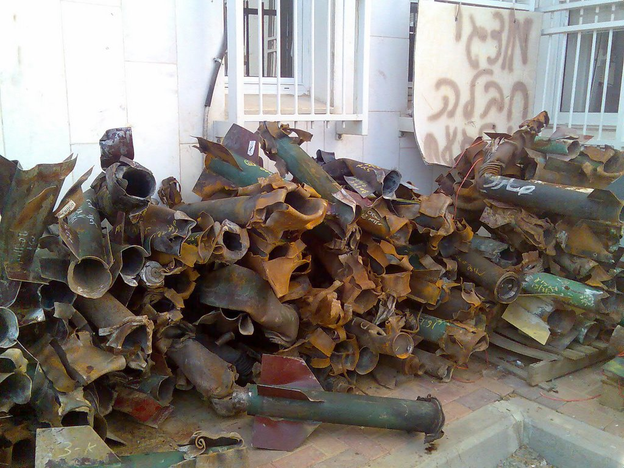
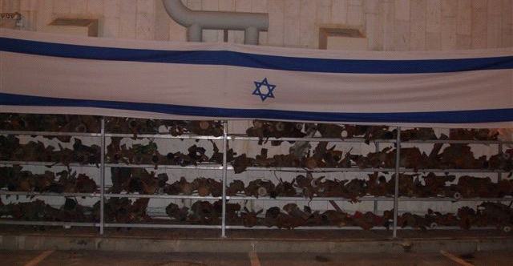
Raining
Rockets
Notes:
http://www.aipac.org/slideshows/qassamrockets/index.html
Residents of the Israeli towns near the Gaza border, including Sderot, have for years been on the front lines of Hamas’ terror war against the Jewish state. In 2007, Palestinian terrorists have fired more than 2,000 Qassam rockets at Israeli civilians.
Shot indiscriminately, the rockets have hit homes, schools and synagogues, injured dozens and killed eight people. The Israeli Red Dawn warning system gives residents only about 15 seconds to take cover from an incoming rocket attack. While most of the attacks have hit civilian areas, 69 Israeli soldiers based in the western Negev were wounded on Sept. 11 when a Qassam rocket hit near their tent as they were sleeping. A spokesman from the terrorist group Hamas called the attack a “victory from God.”
Hamas’ recent violent takeover of the Gaza Strip has only exacerbated the threat to Israel. The Iranian-backed terrorist group continues to smuggle massive amounts of weapons through tunnels under the Gaza-Egypt border. Israel has demonstrated extreme restraint as its citizens face bombardment, but may be forced to take stronger steps to forestall the growing threat to its civilian population.
For additional pictures, see http://www.israelnationalnews.com/News/News.aspx/125430

Slide 2
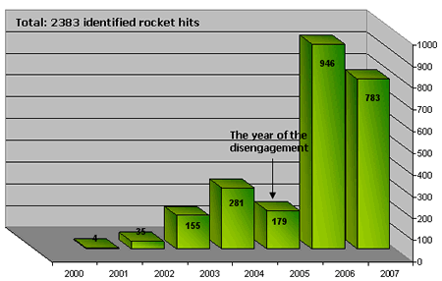
A Continuous Barrage
(2007 data through November 30.)
Notes:
Source: “Rocket threat from the Gaza Strip, 2000-2007”
Intelligence and Terrorism Information Center at the Israel Intelligence Heritage & Commemoration Center (IICC), December 2007
http://www.terrorism-info.org.il/eng/eng_n/rocket_threat_e.htm
This study concentrated all the data and examined the Palestinian terrorist organization policy of rocket and mortar fire, beginning when confrontation started in 2000 and going through October 2007. An examination of the following graph shows the number of attacks gradually grew (2001-2004) until the disengagement (2005), when there was a temporary drop. However, in the two following years (2006-2007) there was a sharp increase and rockets became the main weapons in the hands of the Palestinian terrorist organizations.

Slide 3
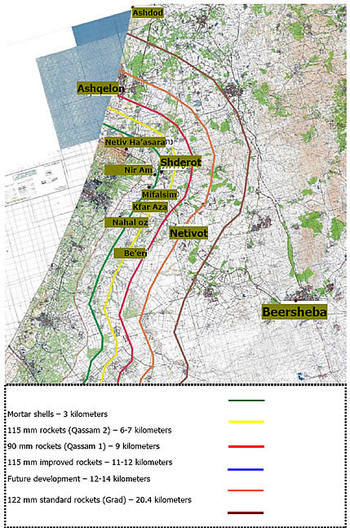
Rocket Range
Notes:
Source: “Rocket threat from the Gaza Strip, 2000-2007,” Intelligence and Terrorism Information Center at the Israel Intelligence Heritage & Commemoration Center (IICC), December 2007
Summary: http://www.terrorism-info.org.il/eng/eng_n/rocket_threat_e.htm
Full text: http://www.terrorism-info.org.il/malam_multimedia/English/eng_n/pdf/rocket_threat_e.pdf
(Photos courtesy of the Sderot Communications Center)
Qassam rockets have already landed in Ashkelon, including three this week (Tuesday, February 5).
http://www.ynetnews.com/articles/0,7340,L-3503303,00.html
Ashkelon is a city of over 100,000 on the Mediterranean coast, approximately 35 miles south of Tel Aviv (about the distance between us and Tacoma)

Slide 4
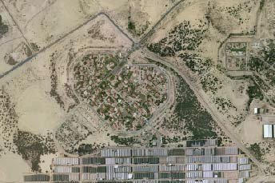
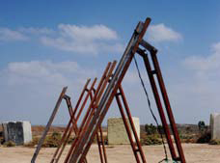
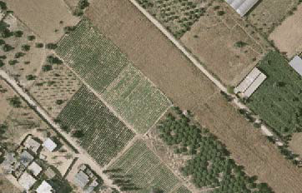
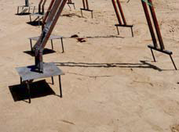
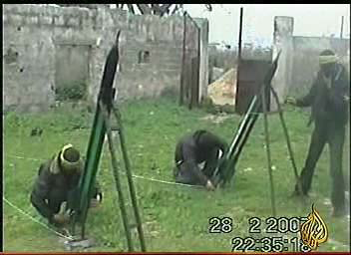
Notes:
Source: “Rocket threat from the Gaza Strip, 2000-2007,” Intelligence and Terrorism Information Center at the Israel Intelligence Heritage & Commemoration Center (IICC), December 2007
Summary: http://www.terrorism-info.org.il/eng/eng_n/rocket_threat_e.htm
Full text: http://www.terrorism-info.org.il/malam_multimedia/English/eng_n/pdf/rocket_threat_e.pdf
(Photos courtesy of the Sderot Communications Center)
See also:
“Missile fire from Gaza on Israeli civilian targets,” Israel Ministry of Foreign Affairs, February 1, 2008
http://www.mfa.gov.il/MFA/Terrorism-+Obstacle+to+Peace/Palestinian+terror+since+2000/Missile+fire+from+Gaza+on+Israeli+civilian+targets+Aug+2007.htm
“2,000 Qassam Rockets and Mortars Fired at Israel from Gaza in 2007,” The Israel Project, December 5, 2007
http://www.theisraelproject.org/site/c.hsJPK0PIJpH/b.672631/apps/s/content.asp?ct=4802515

Slide 5
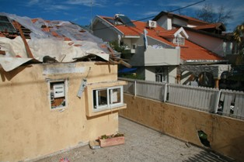
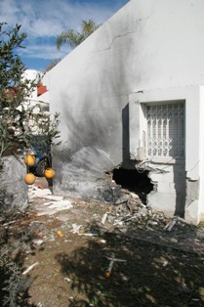
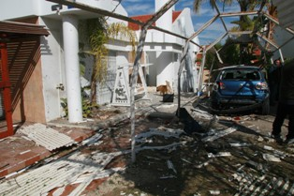
Notes:
Top left: A home that took a direct hit on Jan. 16, 2008 in Sderot
Bottom left: The garage of a Sderot home that was hit by a short-range rocket fired from Gaza on Jan. 17, 2008
Right: A Sderot home that took a direct hit on Jan. 17, 2008
(Source: The Israel Project, http://www.theisraelproject.org/site/?c=hsJPK0PIJpH&b=3831671)

Slide 6
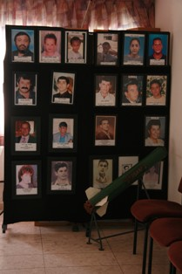
Notes:
A memorial in Sderot’s city hall dedicated to those that have been killed by rockets fired from Gaza
(Source: The Israel Project, http://www.theisraelproject.org/site/?c=hsJPK0PIJpH&b=3831671)

Slide 7
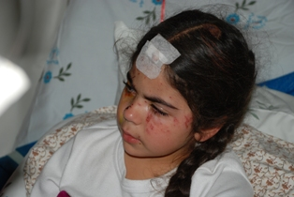
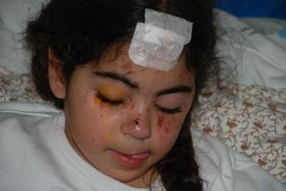
Notes:
Five-year-old Lior Ben-Shimon who was seriously wounded when a rocket directly hit her neighbor’s home, where she was playing Jan. 16, 2008
(Source: The Israel Project, http://www.theisraelproject.org/site/?c=hsJPK0PIJpH&b=3831671)

Slide 8
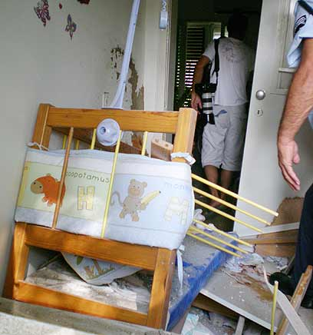
Notes:
Baby crib destroyed by Qassam, July 23, 2007
http://www.ynetnews.com/articles/0,7340,L-3428921,00.html

Slide 9
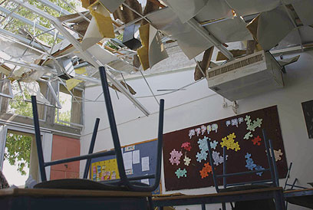
Notes:
High-school classroom in Sderot hit by Qassam rocket, May 17, 2007
Source: http://www.ynetnews.com/articles/0,7340,L-3401172,00.html

Slide 10
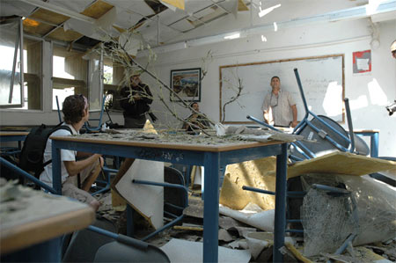
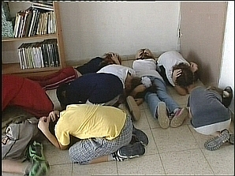
Notes:
Classroom that took a direct hit; children waiting for the explosion
(Source: Consulate General of Israel, New York)
See also video clip at: http://www.youtube.com/watch?v=GyM9Wg-5t98 which features a slide show (2’12”) with some of the same photos.

Slide 11
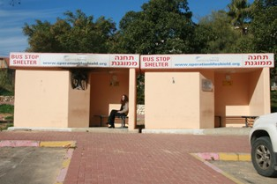
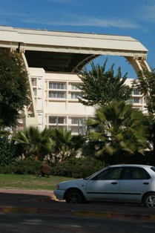
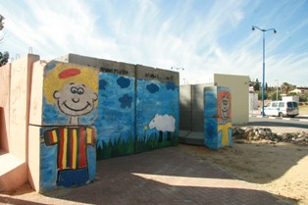
Notes:
Left: A reinforced elementary school in downtown Sderot where children study everyday under fire
Top right: Bus stops in Sderot, notably reinforced with concrete, to protect those standing in open space from the daily barrage of rockets fired from Gaza
Bottom right: A children’s bomb shelter in Sderot
(Source: The Israel Project, http://www.theisraelproject.org/site/?c=hsJPK0PIJpH&b=3831671)

Slide 12
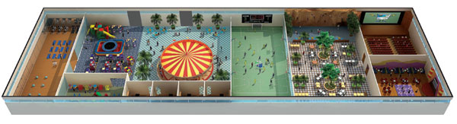
Rock Climbing Wall/ Play Equipment
Aerobics/Dance
Studio & Shelter
Children’s Play
Area (ages 7-12)
Merry-Go-
Round
Movie Theater
& Shelter
Toddler Play Area & Shelter
Counseling Center & Health Clinic
Teen Disco
& Shelter
Multi-Purpose Playing Field
Café
Notes:
Sderot Indoor Playpark
The Jewish National Fund (JNF) helped build the Sderot Indoor Playground, the largest indoor playpark in Israel, set to open in November 2008. It is expected to open in November 2008 at a cost about $6 million to build and to be used by 20,000 people a year, attracting visitors from around the area.
To protect Sderot’s children, the playground will be fortified to the rigorous standards of the Israel Defense Forces. This all inclusive playground, exercise and recreational facility for children age 16 and under will provide Sderot’s youth with a place to have fun, connect with friends and be children, beyond the conflict. And parents will have peace of mind knowing that their children are playing in an environment that is safe and secure. It is estimated that the Sderot Indoor Playground will be used by 20,000 people a year. It will attract visitors from around the area and be a point of pride for the State of Israel.
Where else in the world would you find a counseling center co-located with a playground and sports field, all in a fortified structure designed to withstand missile and rocket attacks??!....
Source: JNF, http://www.jnf.org/site/PageServer?pagename=The_sapphire_society_info, Sept. 2008

Slide 13
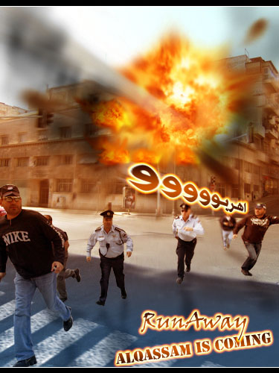
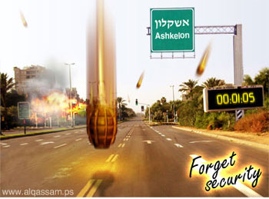

Notes:
March 2008: Posters, displayed prominently on Hamas web sites, with captions that leave no room for misunderstandings.
Sources: http://www.alqassam.ps/arabic/
Israeli Ministry of Foreign Affairs:
http://www.mfa.gov.il/MFA/Terrorism-+Obstacle+to+Peace/Hamas+war+against+Israel/Hamas+websites+tell+Israelis-+We+want+you+dead.htm
Intelligence and Terrorism Information Center at the Israel Intelligence Heritage & Commemoration Center (IICC), March 3, 2008
“Five days of escalation in the Gaza Strip: a total of 180 rockets fired. Greater numbers of standard, factory-manufactured Grad rockets continuously hit Ashqelon. IDF forces operate in the northern Gaza Strip and air strikes against terrorist targets continue. Two IDF soldiers and 80 Palestinians (most of them terrorists) killed.”
http://www.terrorism-info.org.il/malam_multimedia/English/eng_n/html/ct_020308e.htm#a

