Slide 1
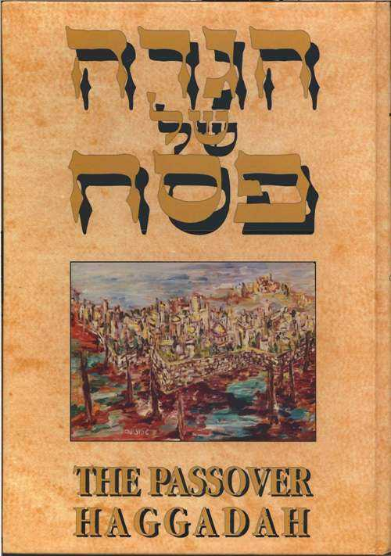

Slide 2
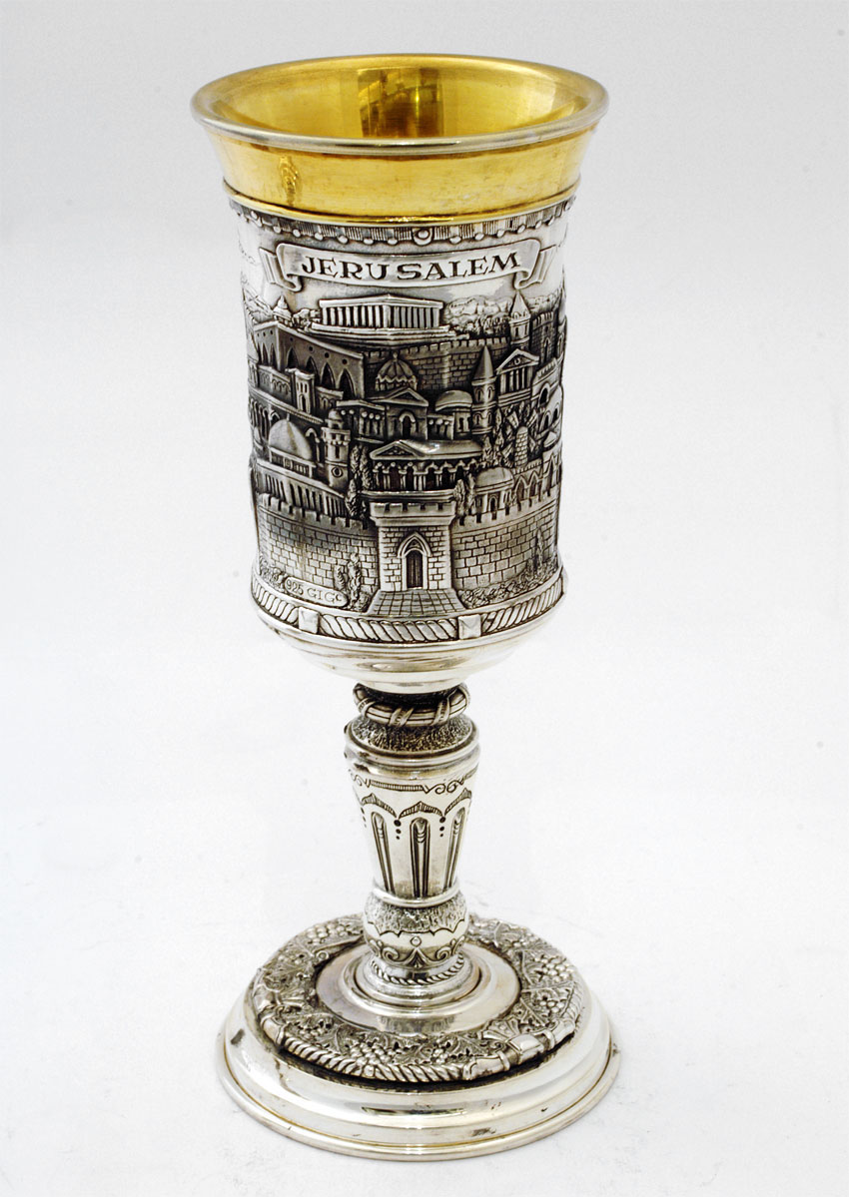
Notes:
Source: http://www.ivoryandart.com/servlet/the-919/silver-judaica--dsh--kiddush/detail
Silver Judaica - Kiddush Cup - Jerusalem Big

Slide 3
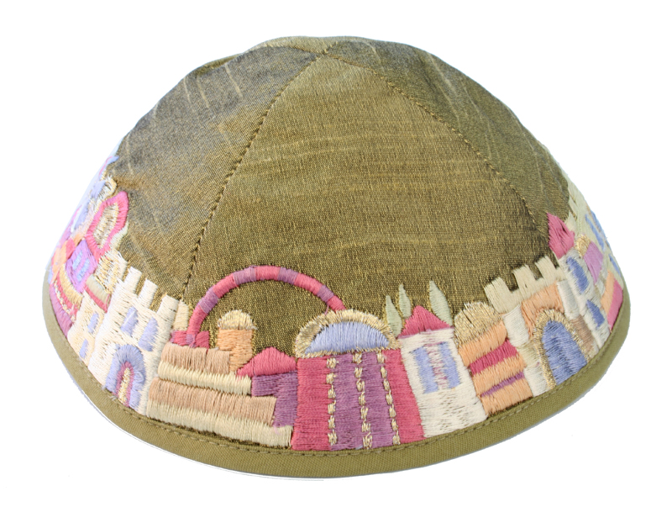
Notes:
Source: http://www.judaicawebstore.com/ProductInfo.aspx?productid=EL-YME-1G
Yair Emanuel embroidered silk kippah, Jerusalem olive

Slide 4
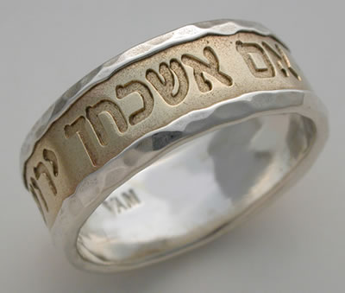
Notes:
Source: http://www.jewishgiftplace.com/Jerusalem-Jewish-Wedding-Band.html
14K solid yellow gold band inlaid in a sterling silver ring with hammered edges. The gold is inscribed with the Hebrew words, "If I Forget You, Oh Jerusalem, Let My Right Hand Wither," Psalms 137. Handcast and handmade.

Slide 5
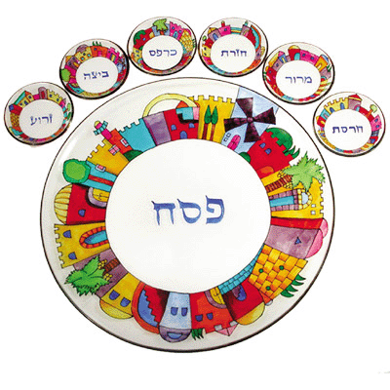
Notes:
Source: http://www.judaism.com/display.asp?nt=ajcNCp&etn=FHBBE&aref=JAHistory
Jerusalem Seder Plate – Glass, hand-painted by Yair Emanuel

Slide 6
Notes:
Source: http://www.smallsigns.net/ceramic-signs-jerusalem.html
Jerusalem Skyline door nameplate, ceramic tile decorated with landmarks from the Jerusalem skyline and the Bible's Seven Species of the Land of Israel

Slide 7
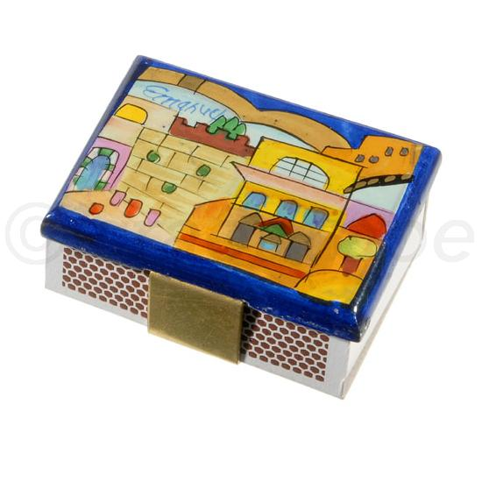
Notes:
Source: http://www.israelathome.com/ICV/nav/cat/catalogue/1/Shabbat/7/Candlesticks/9/Candles%20&%20accessories/398/Emanuel%20Match%20Box/

Slide 8
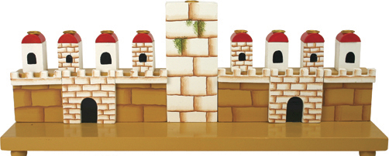
Notes:
Source: http://www.thecraftshoponline.com/productcart/pc/viewPrd.asp?idcategory=157&idproduct=2035
Assemble-it-yourself wooden craft Jerusalem Menorah

Slide 9
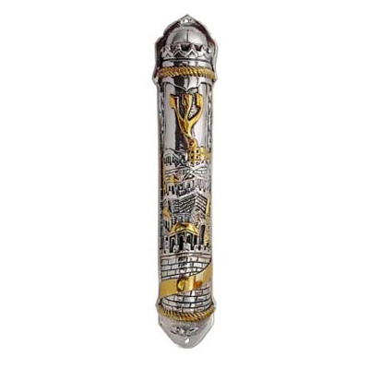
Source:

Slide 10
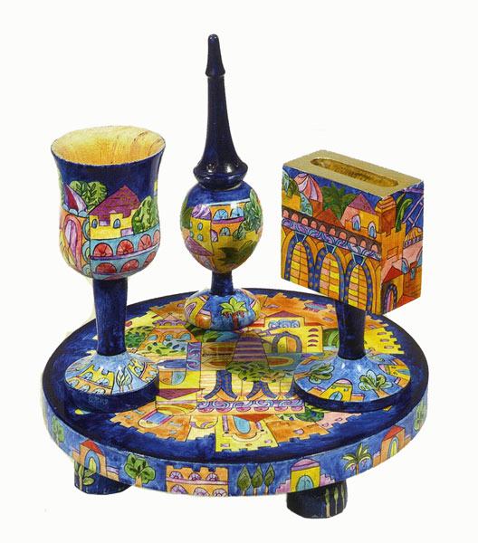
Notes:
Source: http://www.israelathome.com/ICV/nav/cat/catalogue/1/Shabbat/2/Havdalah/3/Havdalah%20sets/186/havdalah%20set

Slide 11
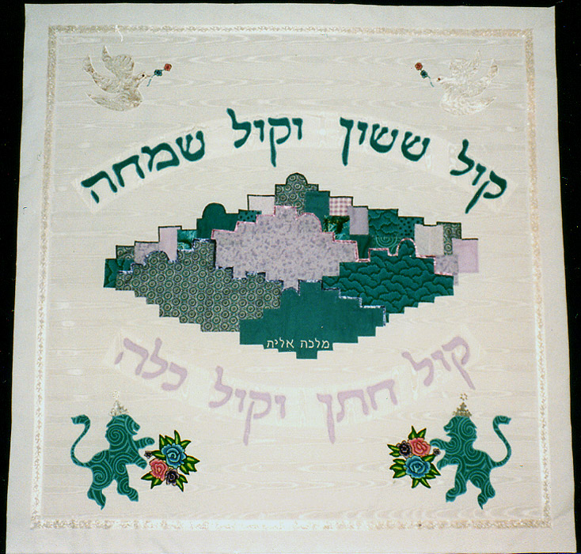
Notes:
Source: http://customjudaica.com/huppot.shtml

Slide 12
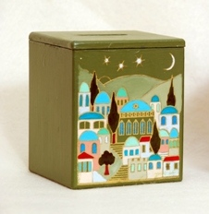
Notes:
Source: http://www.judaicakingdom.com/tzboxscofje.html
Scene of Jerusalem hand-painted on composite wood tzedaka box.

Slide 13
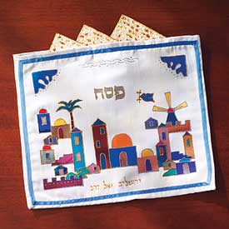
Notes:
http://www.jewishsource.com/itemdy00.asp?T1=256248&Cat=Holiday+%26+Ritual%2EPassover%2EMatzah+Covers

Slide 14
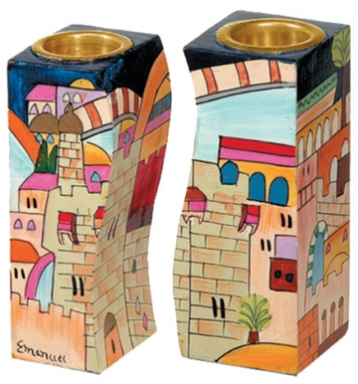
Notes:
Source: http://www.bluewhite.co.uk/index.php?_a=viewProd&productId=78
A pair of wooden hand-painted candlesticks for Shabbat with the Jerusalem design, by Yair Emanuel

Slide 15
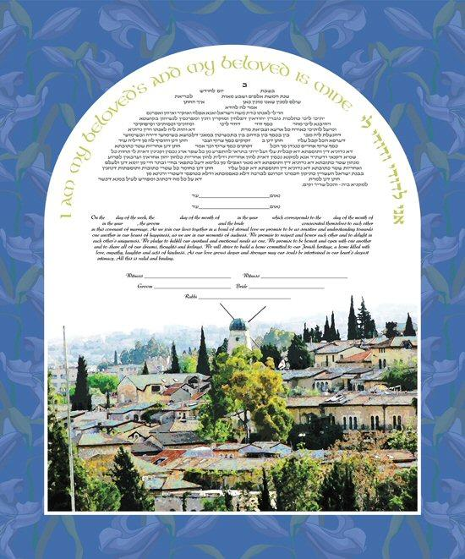
Notes:
Source: http://www.ketubahsandmore.com/catalog/product_info.php?products_id=530&osCsid=a4e58e5a2fc9db7890131803045cb330
Jerusalem Ketubah by Ruth Rudin

Slide 16
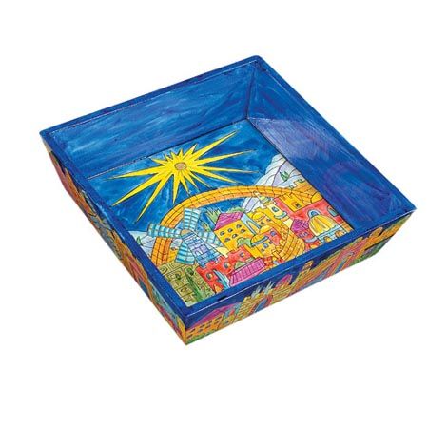
Notes:
Source: http://www.menorah.com/catalog2/shopexd.asp?id=4869
Jerusalem Oriental Matzah Plate

Slide 17
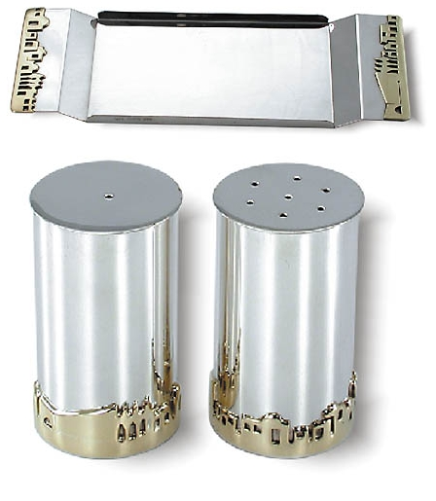
Notes:
Source: http://www.ahuva.com/prod-Salt___Pepper_Set_And_Tray-6568.aspx
Silver Salt & Pepper Shakers with Tray, relief “Jerusalem of Gold” panorama.

Slide 18
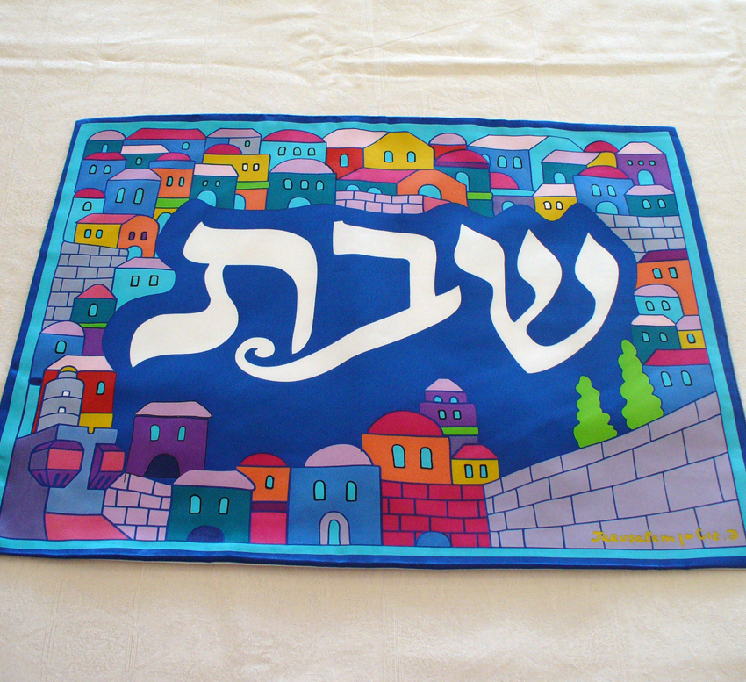
Notes:
Source: http://www.judaicaheaven.com/Detail.bok?no=1099
Silk Jerusalem Challa Cover. Design by Peter Gutman. Dimensions: 19.5'' x 15''

Slide 19
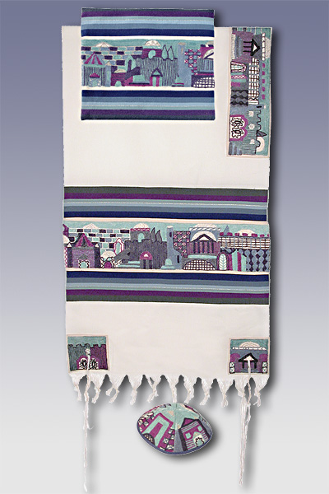
Notes:
Source: http://www.jewish-art-and-gifts.com/tallitot.html
Jerusalem in Blue Set by Yair Emanuel Material: Hand-Embroidered Atara Stripes and Corners - Raw Cotton

Slide 20
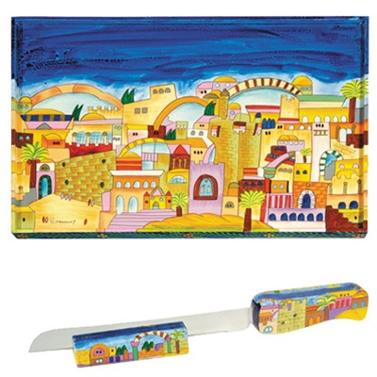
Notes:
Source: http://www.canaan-online.com/PhotoDetails.asp?ShowDESC=N&ProductCode=CB-5
Jerusalem Challah Board by Yair Emanuel

